Slide 1
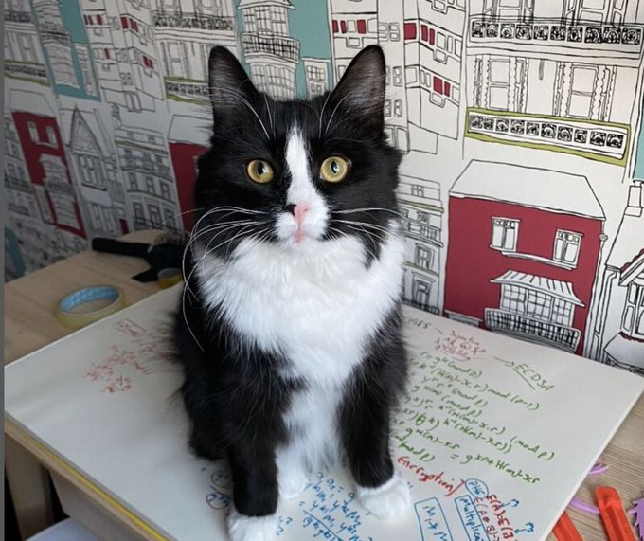
Symmetric Key Basics Block or Stream? Secret Key Methods Salting AES Key Entropy Prof Bill Buchanan OBE https://asecuritysite.com/symmetric

Slide 3
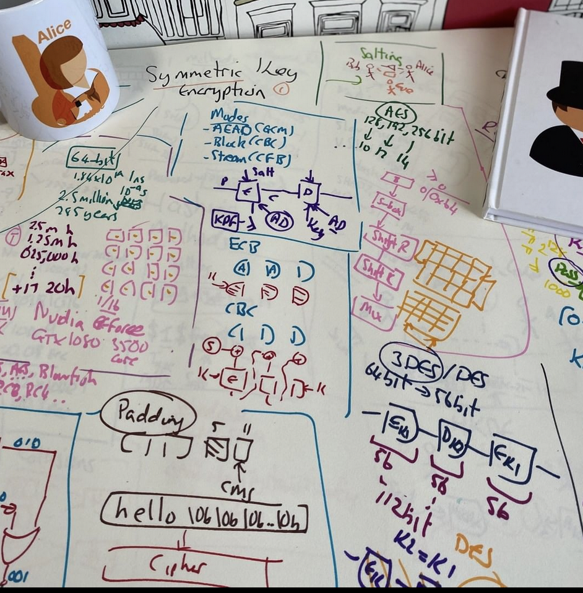
Secret Key Basics Block or Stream? Secret Key Methods Salting AES Key Entropy Prof Bill Buchanan OBE https://asecuritysite.com/symmetric

Slide 5
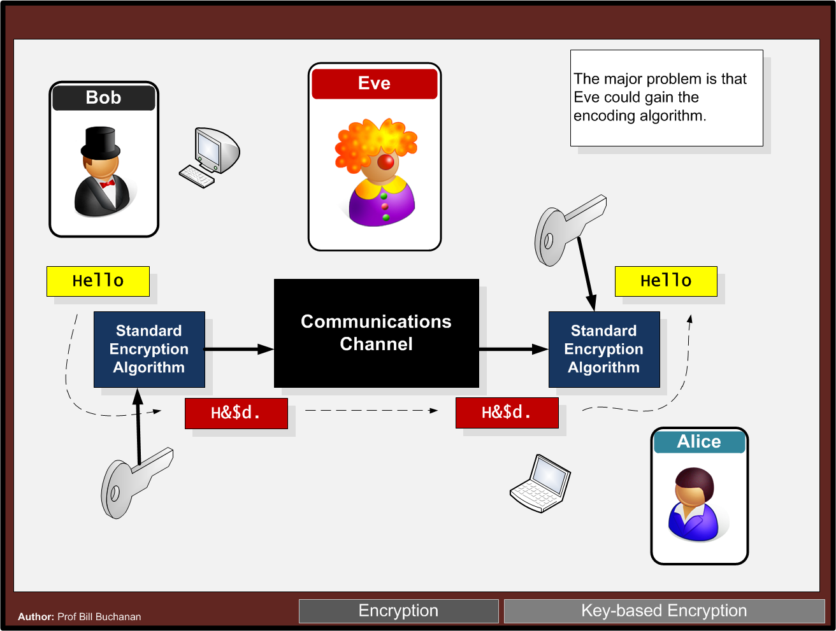

Slide 6
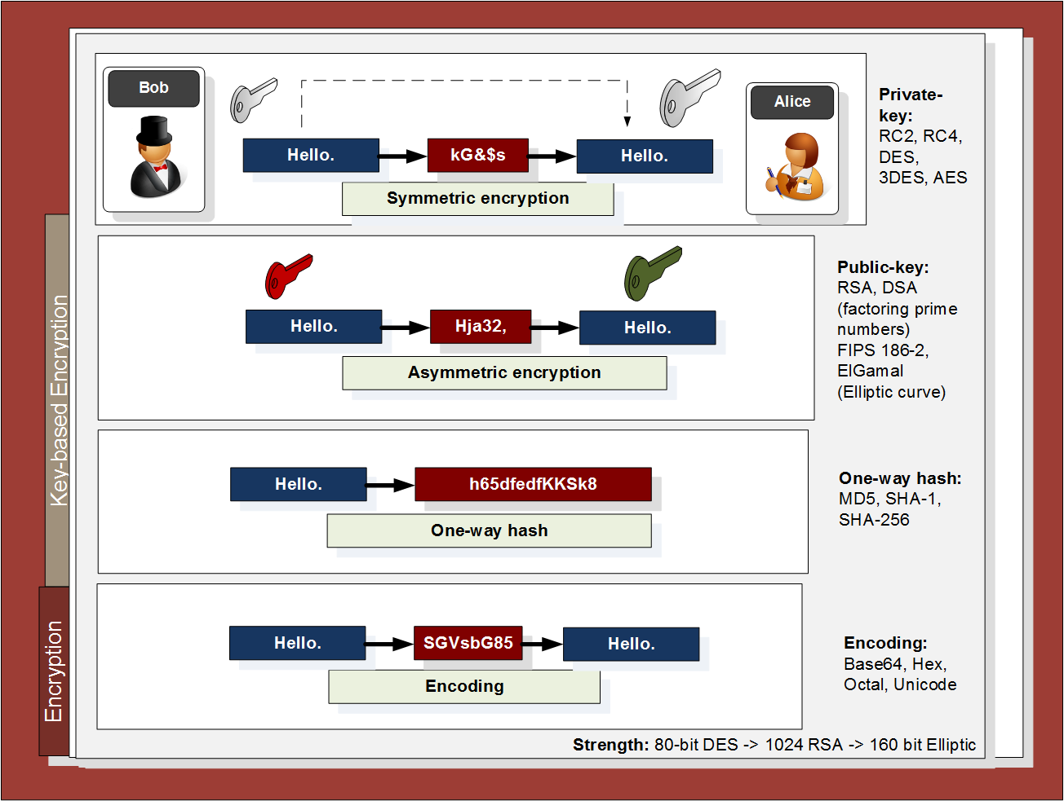

Slide 7
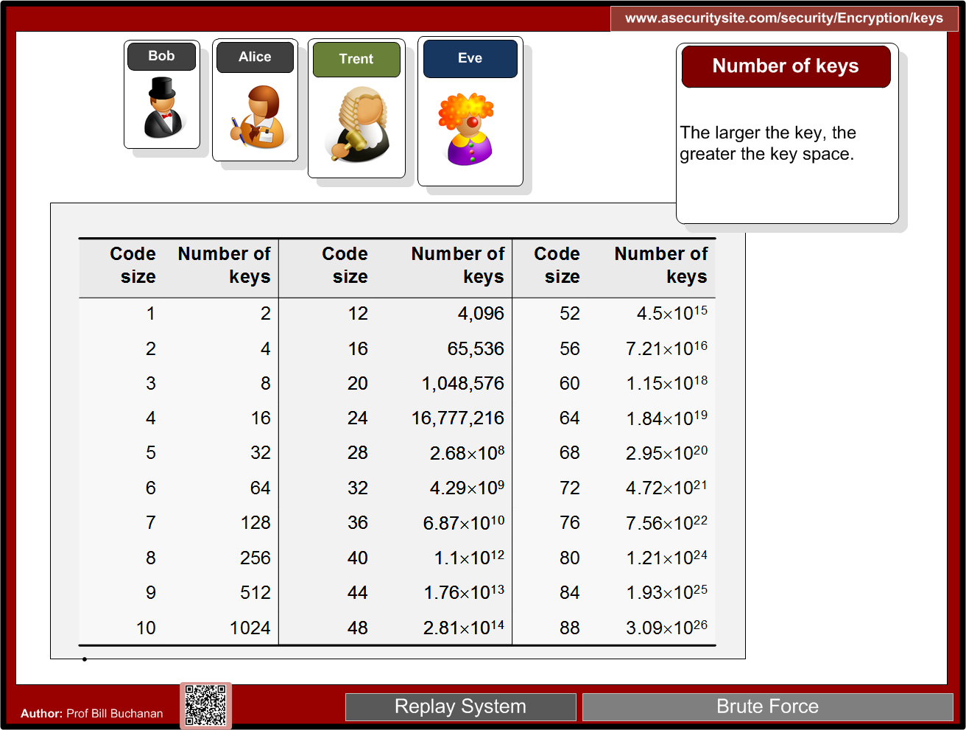
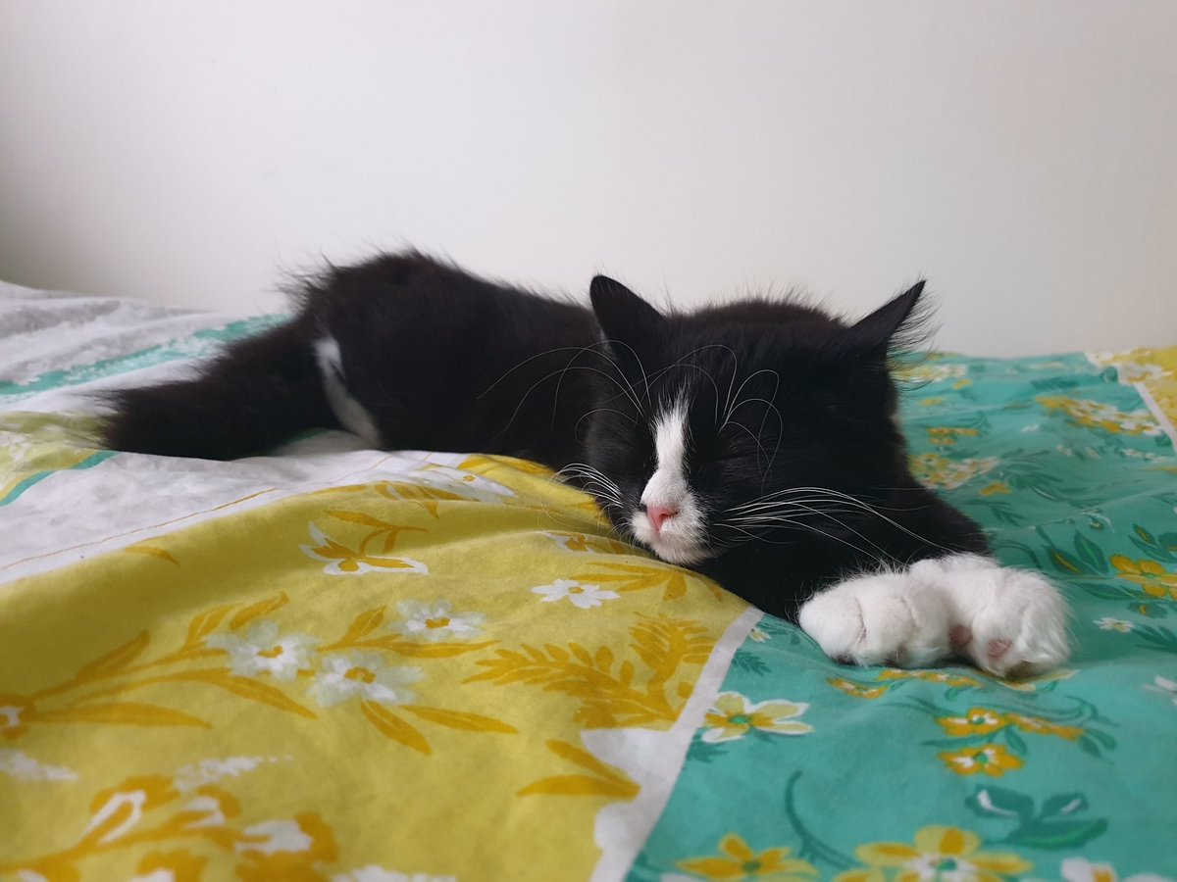
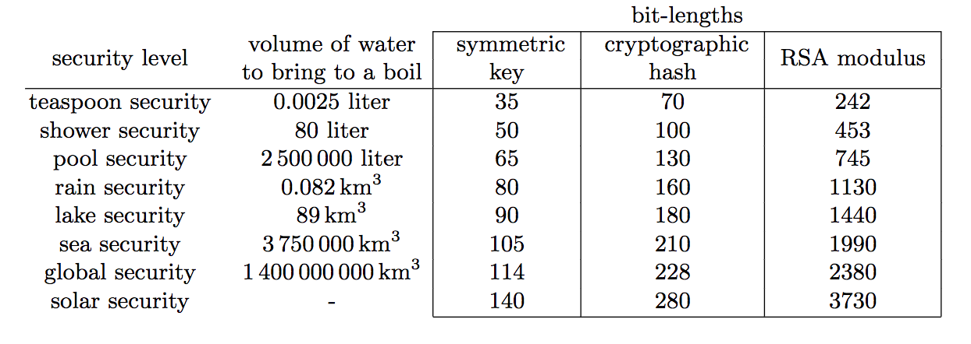

Slide 8
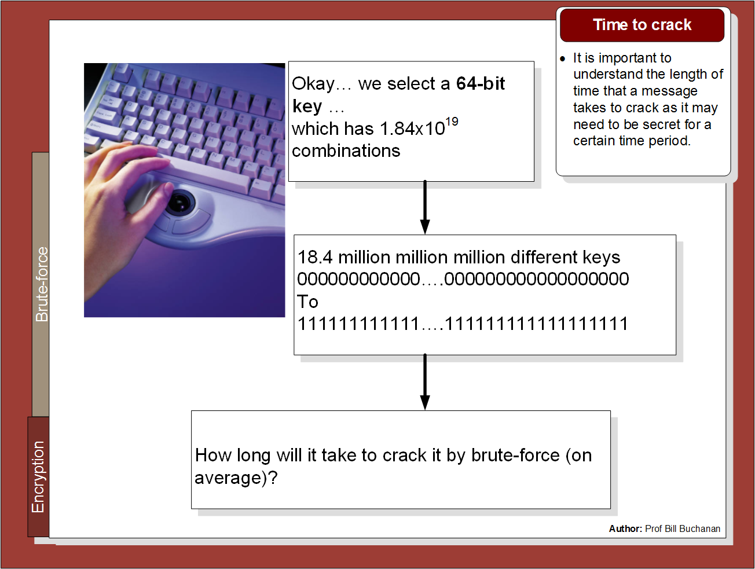

Slide 9
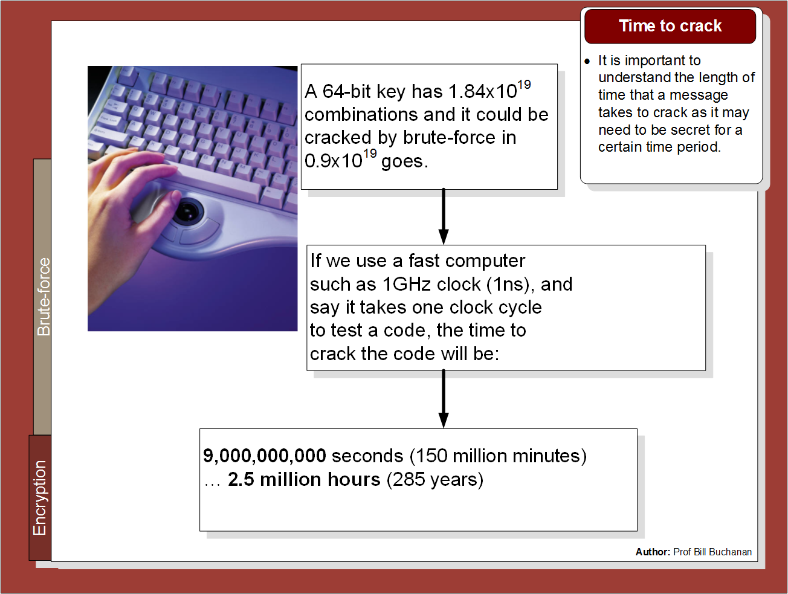

Slide 10
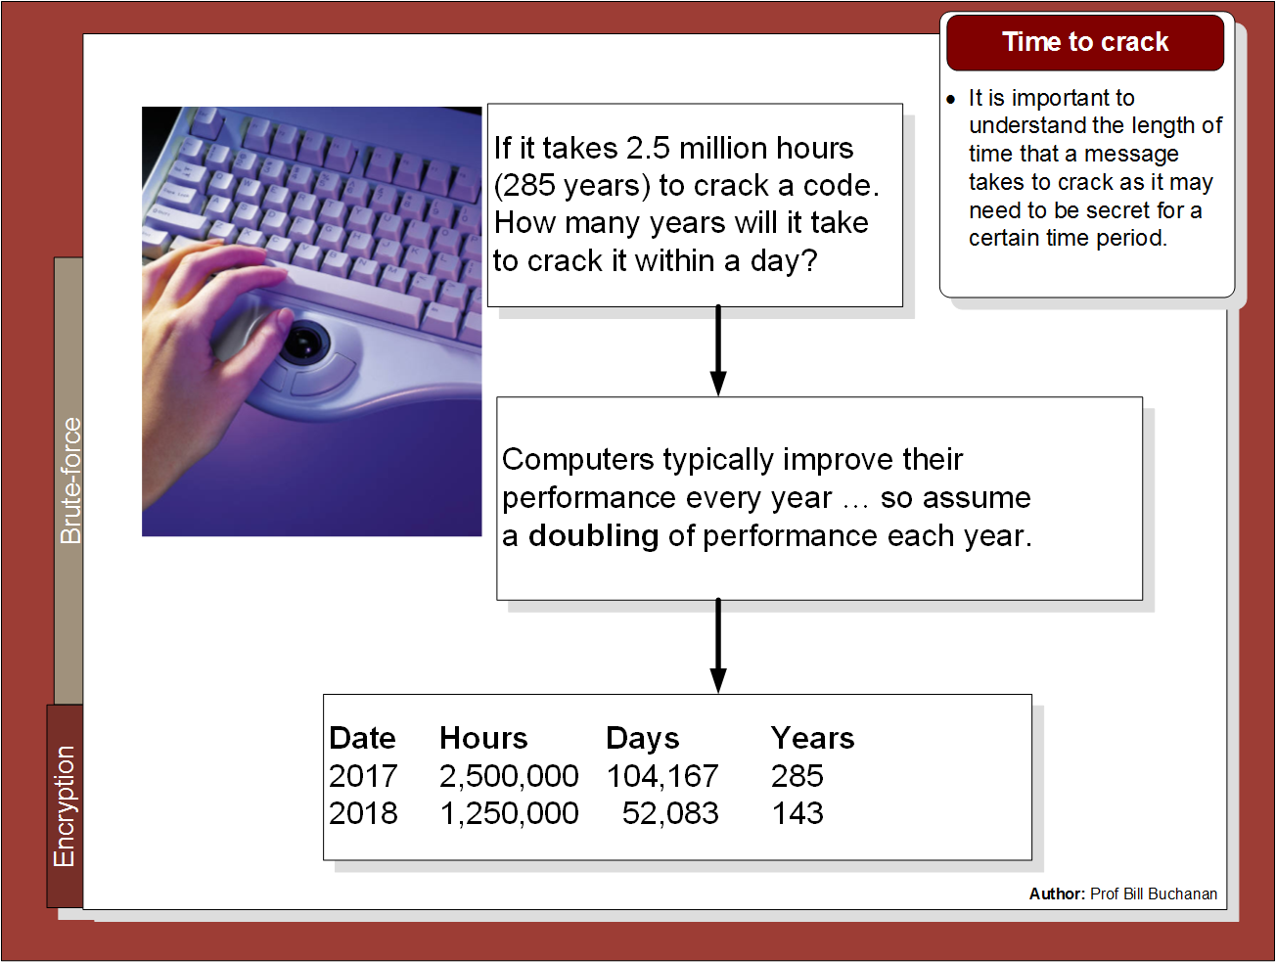

Slide 11
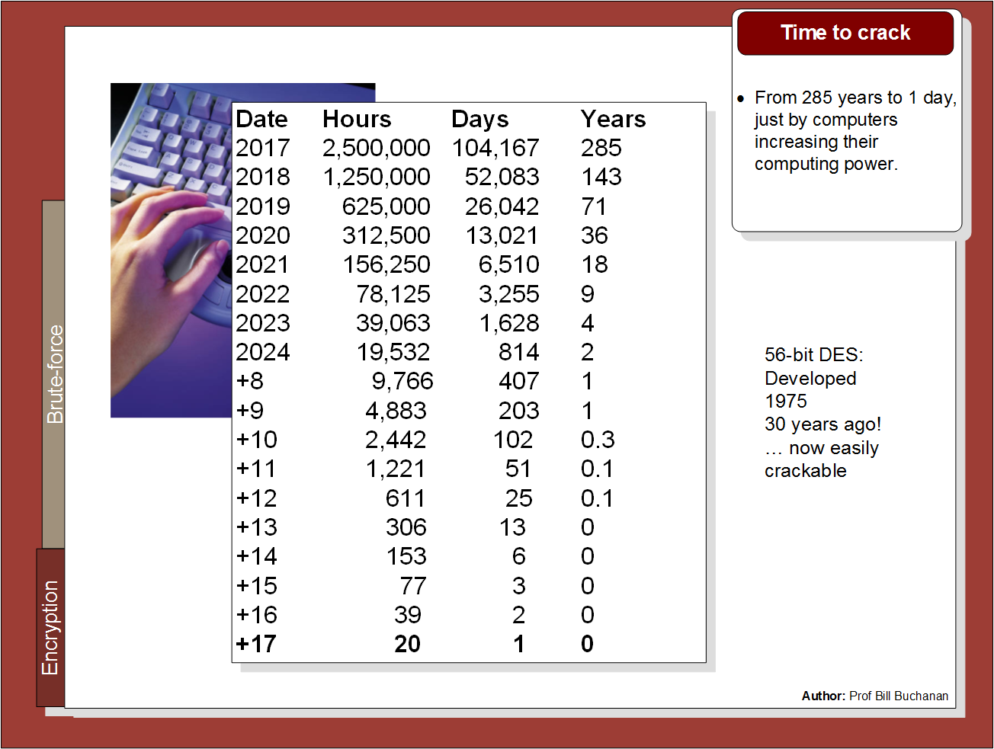

Slide 12
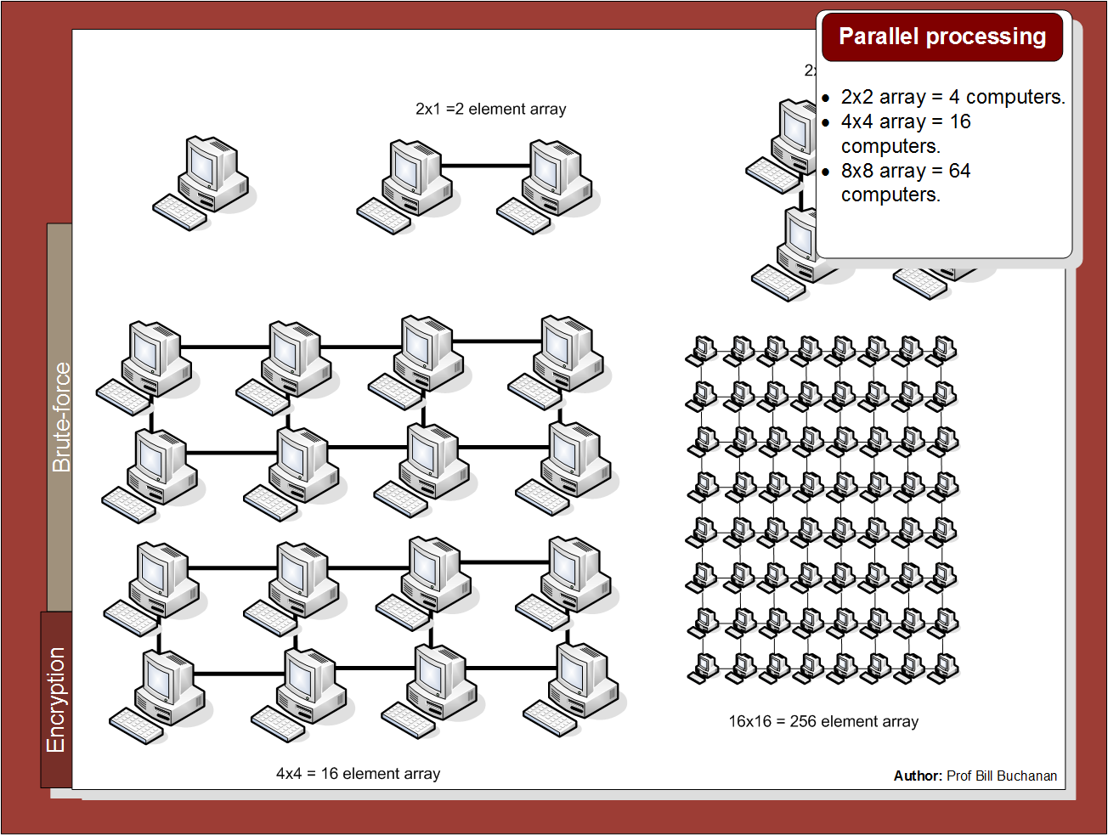

Slide 13
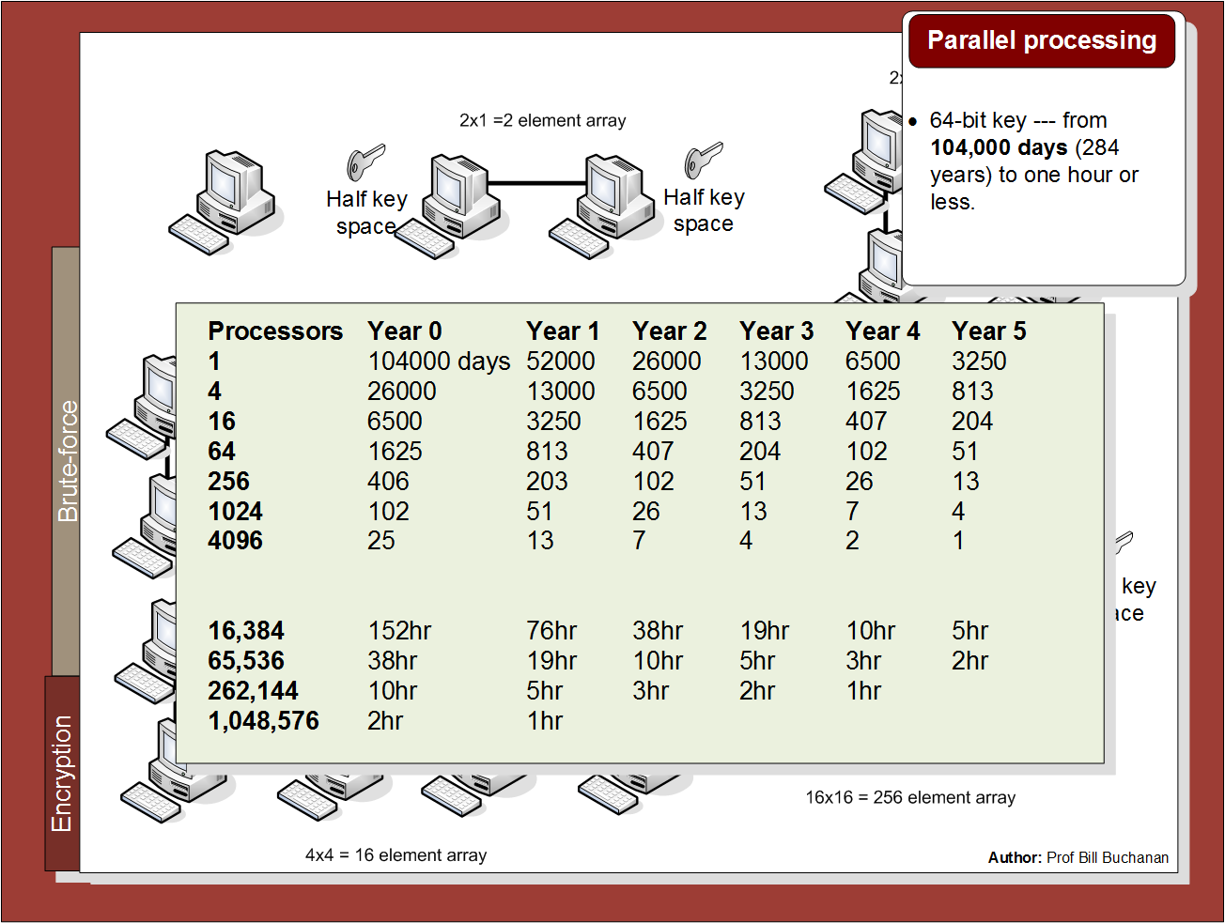

Slide 14
Symmetric Key Basics Block or Stream? Secret Key Methods Salting AES Key Entropy Prof Bill Buchanan OBE https://asecuritysite.com/symmetric

Slide 15
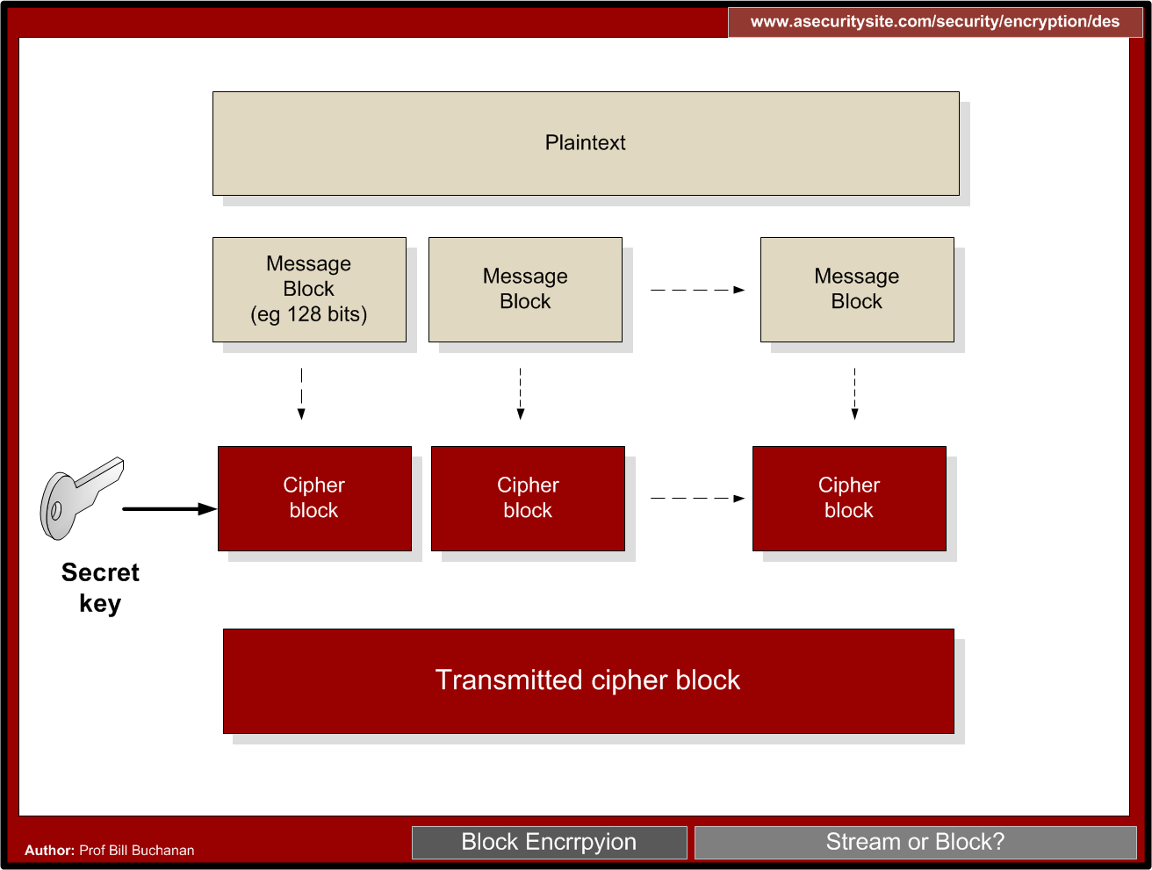

Slide 16
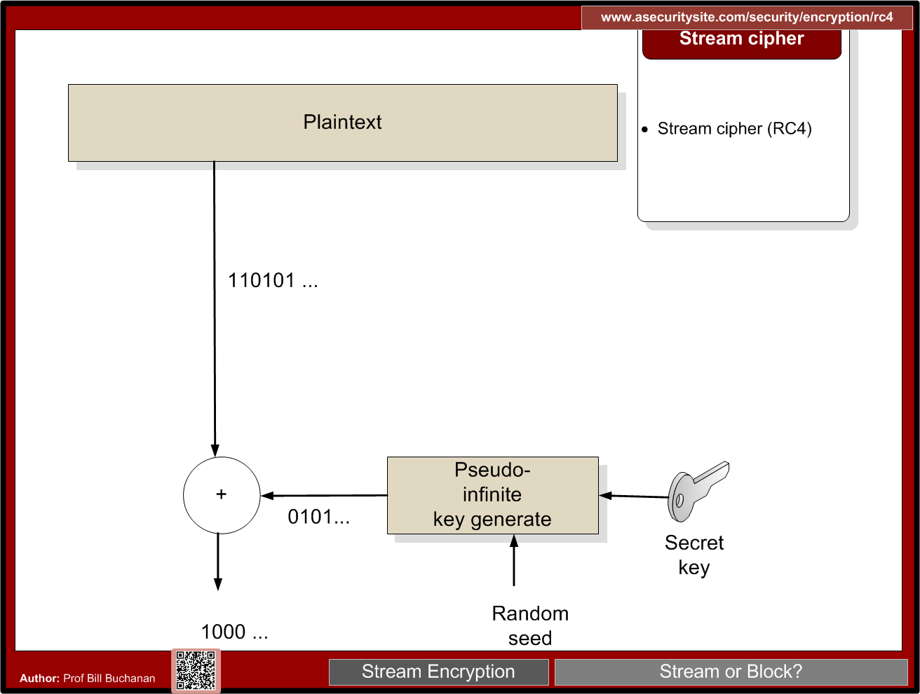

Slide 18
Padding
CMS (Cryptographic Message Syntax). This pads with the same value as the number of padding bytes. Defined in RFC 5652, PKCS#5, PKCS#7 and RFC 1423 PEM.
Bits. This pads with 0x80 (10000000) followed by zero (null) bytes. Defined in ANSI X.923 and ISO/IEC 9797-1.
ZeroLength. This pads with zeros except for the last byte which is equal to the number (length) of padding bytes.
Null. This pads will NULL bytes. This is only used with ASCII text.
Space. This pads with spaces. This is only used with ASCII text.
Random. This pads with random bytes with the last byte defined by the number of padding bytes.

Slide 19
Padding
After padding (CMS): 68656c6c6f0b0b0b0b0b0b0b0b0b0b0b Cipher (ECB): 0a7ec77951291795bac6690c9e7f4c0d
After padding (Bit): 68656c6c6f8000000000000000000000 Cipher (ECB): 731abffc2e3b2c2b5caa9ca2339344f9
After padding (ZeroLen): 68656c6c6f000000000000000000000a Cipher (ECB): d28e2f7e8e44e068732b292bde444245
After padding (Null): 68656c6c6f0000000000000000000000 Cipher (ECB): 444797422460453d95856eb2a1520ece
After padding (Space): 68656c6c6f0000000000000000000000 Cipher (ECB): 444797422460453d95856eb2a1520ece
After padding (Random): 68656c6c6ffc6ecfd884a38798d62a0a Cipher (ECB): c2c88b4364d2c2dc6f2cac9ab73c995d

Slide 20
Symmetric Key Basics Block or Stream? Secret Key Methods Salting AES Key Entropy Prof Bill Buchanan OBE https://asecuritysite.com/symmetric

Slide 22
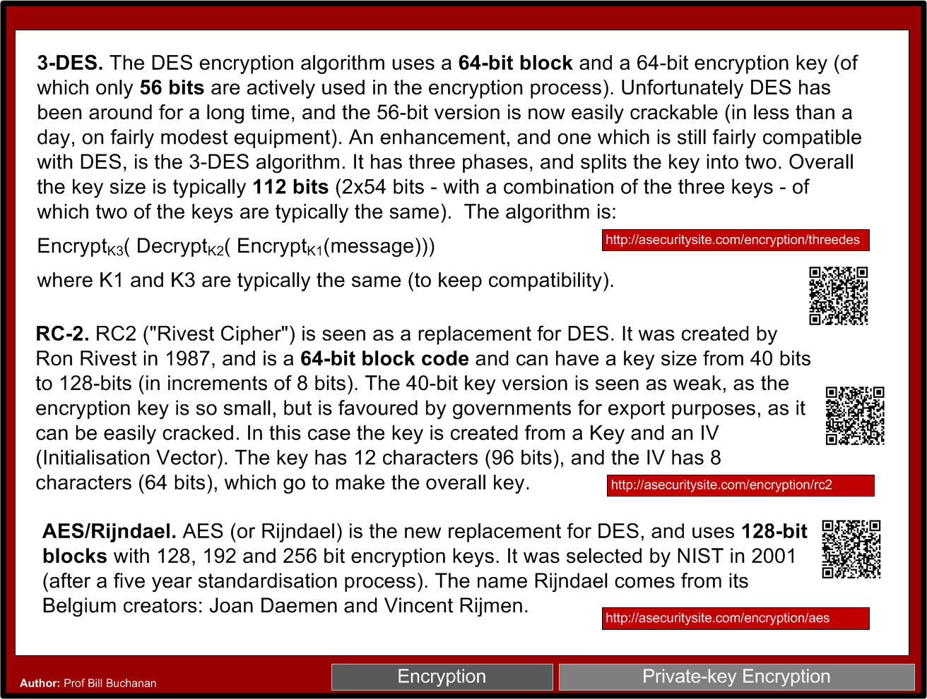

Slide 23


Slide 24
Symmetric Key Basics Block or Stream? Secret Key Methods Salting AES Key Entropy Prof Bill Buchanan https://asecuritysite.com/symmetric

Slide 25
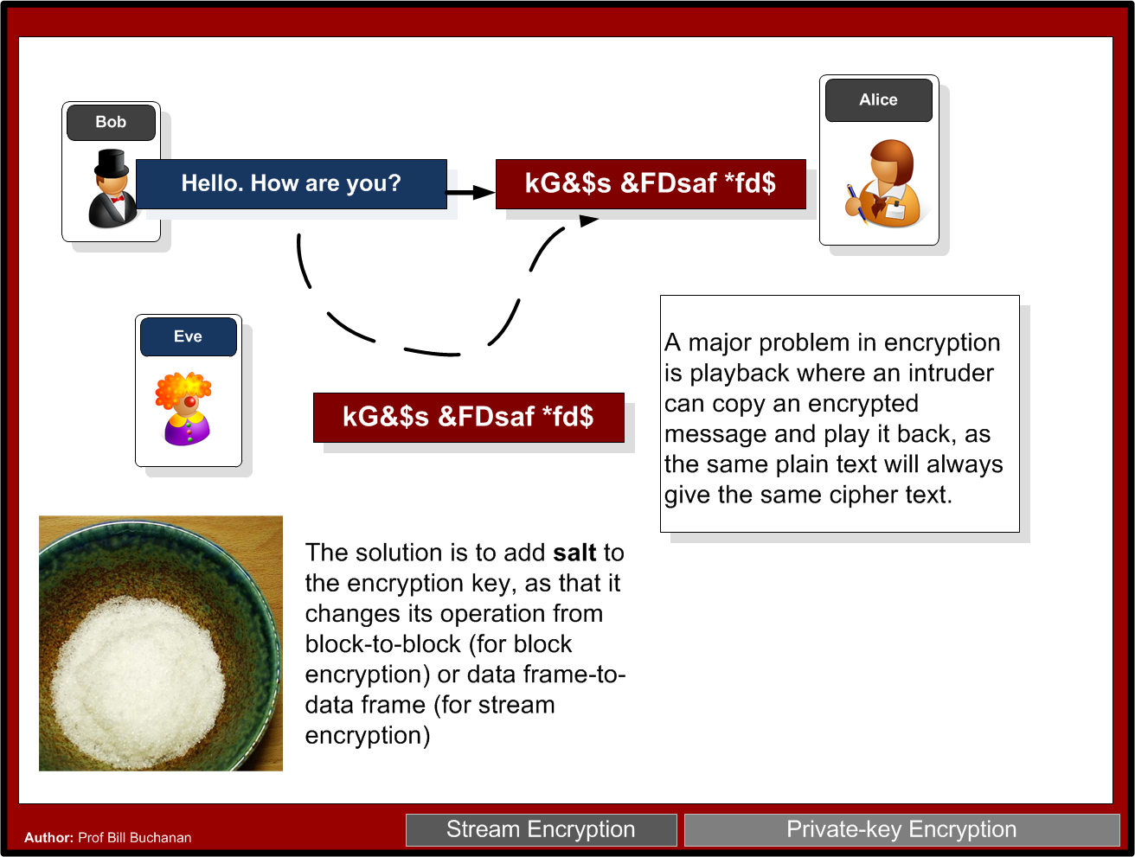

Slide 26
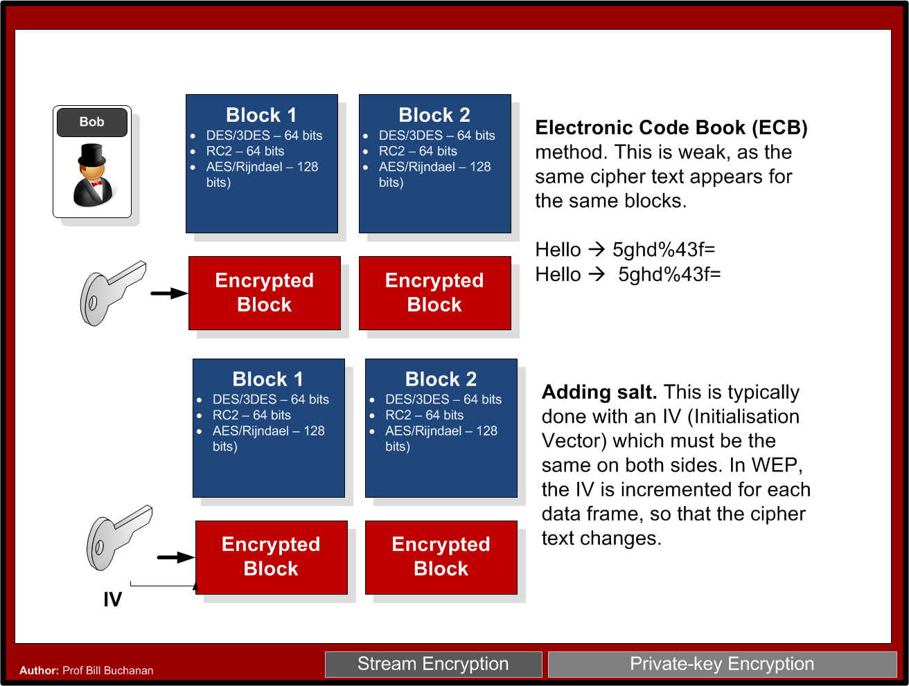

Slide 27
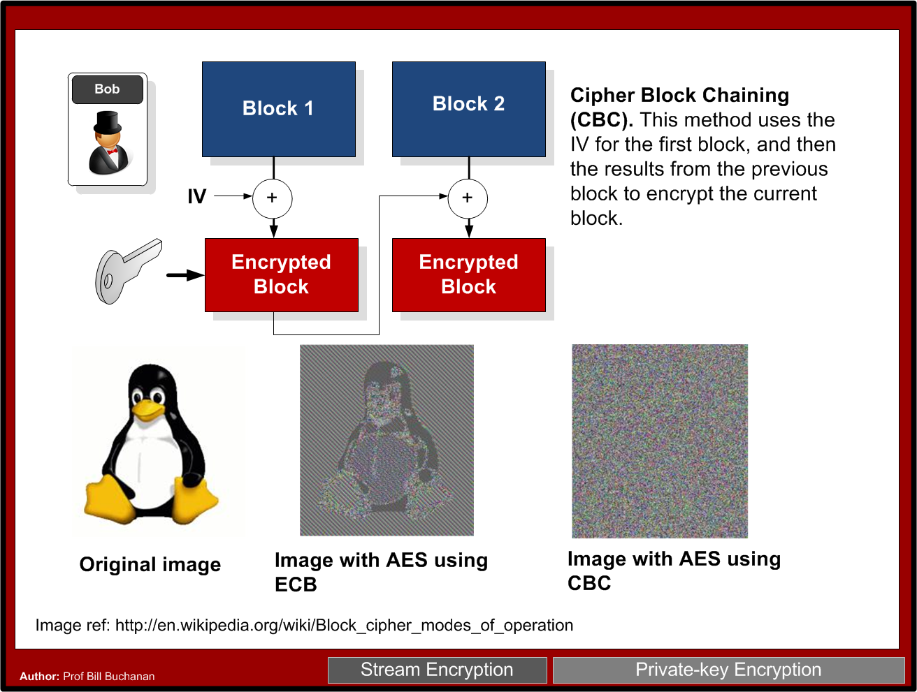

Slide 29
Symmetric Key Basics Block or Stream? Secret Key Methods Salting AES Key Entropy Prof Bill Buchanan https://asecuritysite.com/symmetric

Slide 30
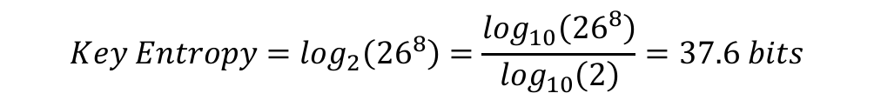
Key Entropy
Password definition | Number of possible characters | Total number of passwords | Entropy (bits)
[0-9] | 10 | 100,000,000 | 26.6
[a-z] | 26 | 2.08827x10¹¹ | 37.6
[a-zA-Z] | 52 | 5.34597x10¹³ | 45.6
[a-zA-Z0-9] | 62 | 2.1834x10¹⁴ | 47.6
[a-zA-Z0-9$%!@+=] | 68 | 4.57163x10¹⁴ | 48.7

Slide 31
Symmetric Key Basics Block or Stream? Secret Key Methods Salting AES Key Entropy Prof Bill Buchanan OBE https://asecuritysite.com/symmetric

Slide 32
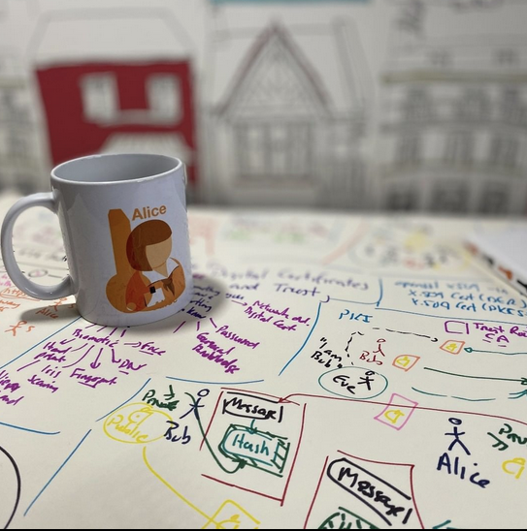
Hashing Hashing Types. Hashing Methods. Salting. Collisions. LM and NTLM Hashes (Windows). Hash Benchmarks. Message Authentication Codes (MACs). OTP/HOTP. Prof Bill Buchanan OBE https://asecuritysite.com/hash

Slide 33
Hashing Hashing Types. Hashing Methods. Salting. Collisions. LM and NTLM Hashes (Windows). Hash Benchmarks. Message Authentication Codes (MACs). OTP/HOTP. Secret Shares. Prof Bill Buchanan OBE https://asecuritysite.com/hash

Slide 34
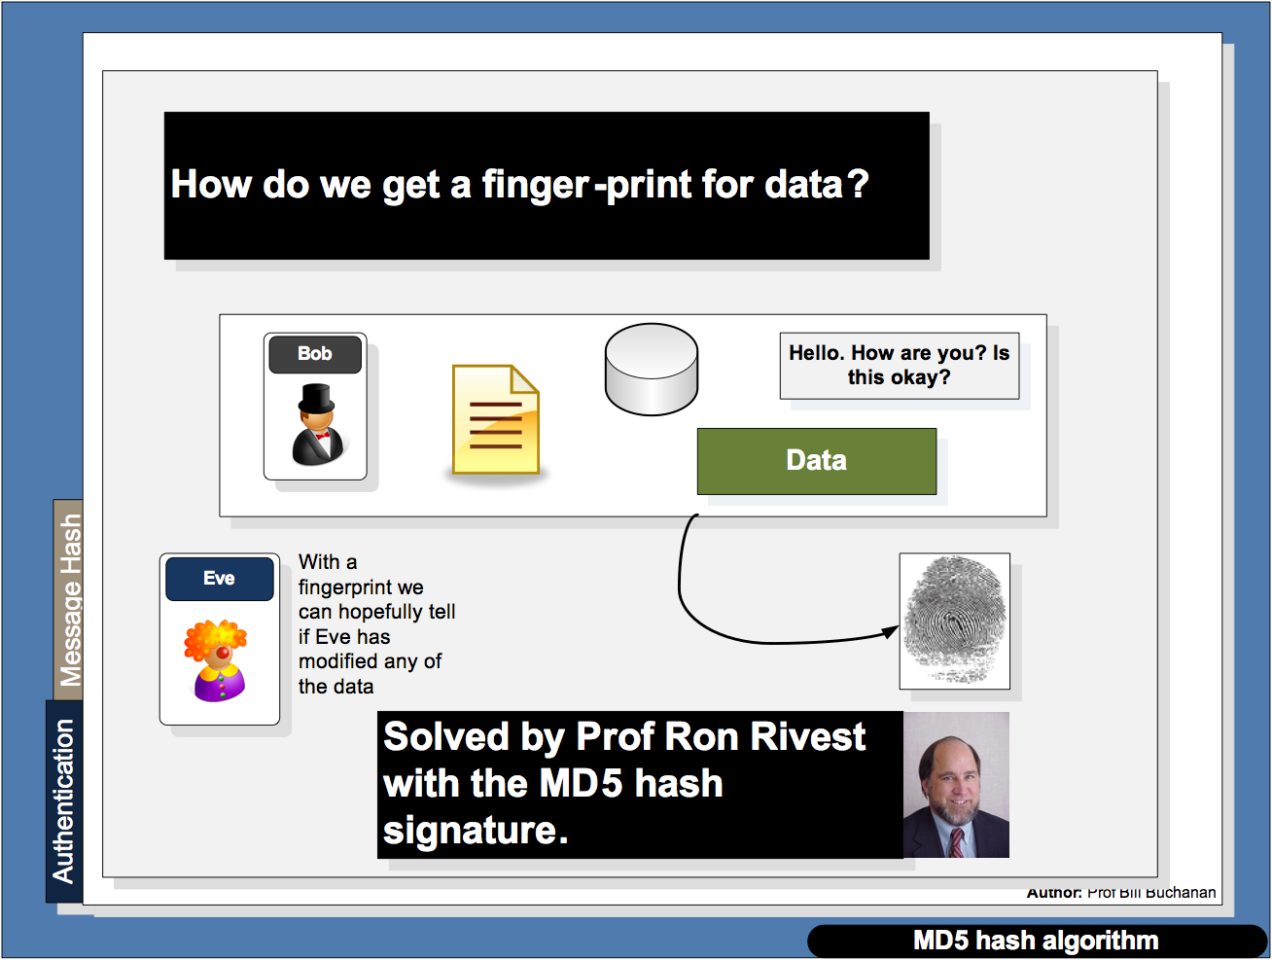

Slide 35
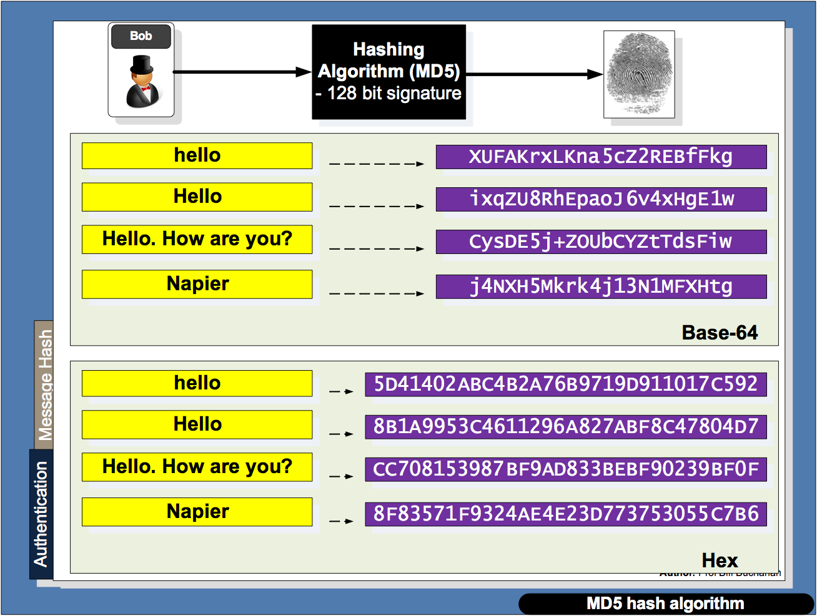

Slide 36
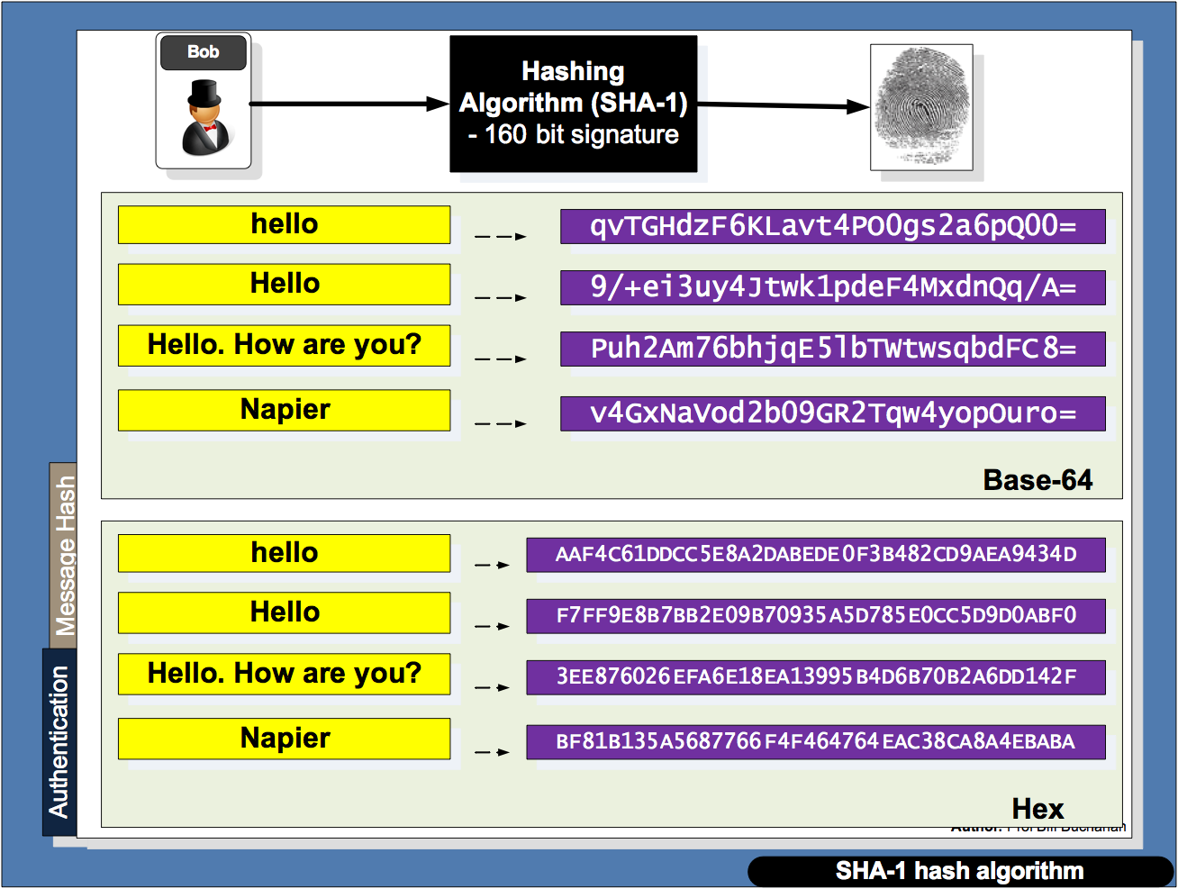

Slide 37
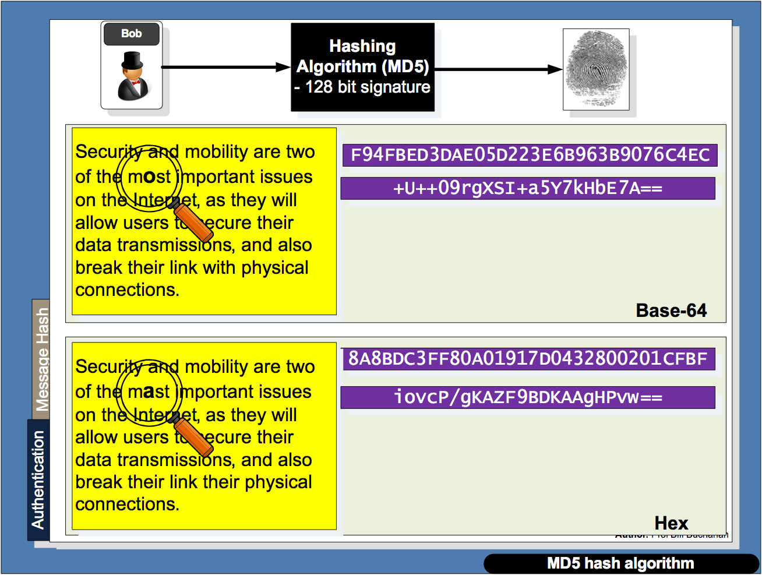

Slide 38
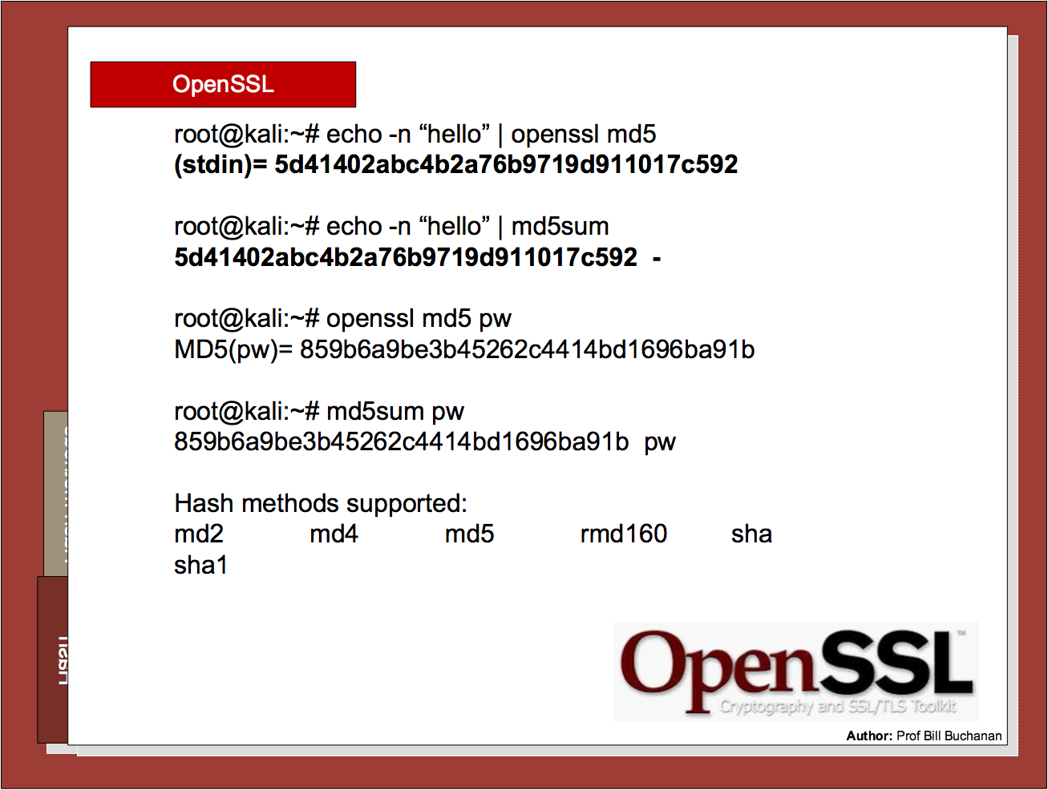

Slide 39
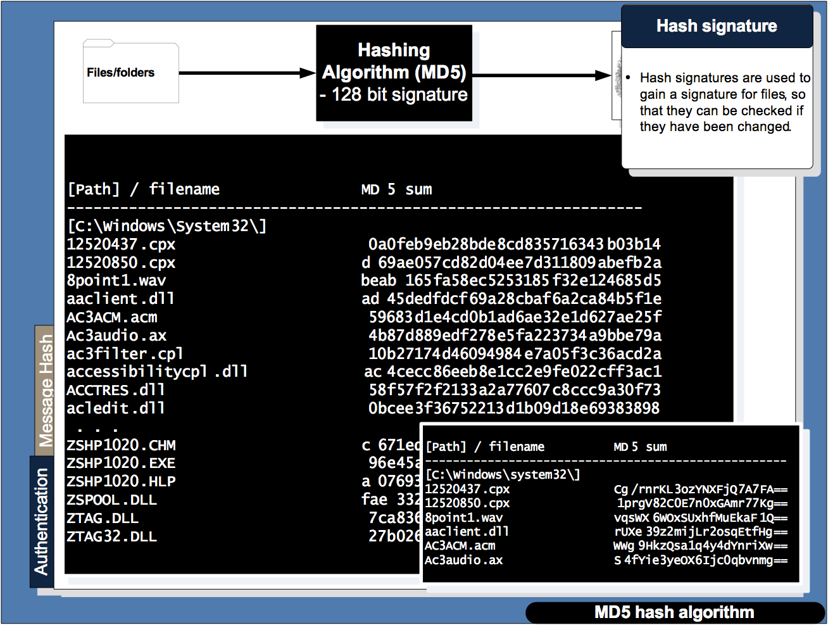

Slide 40
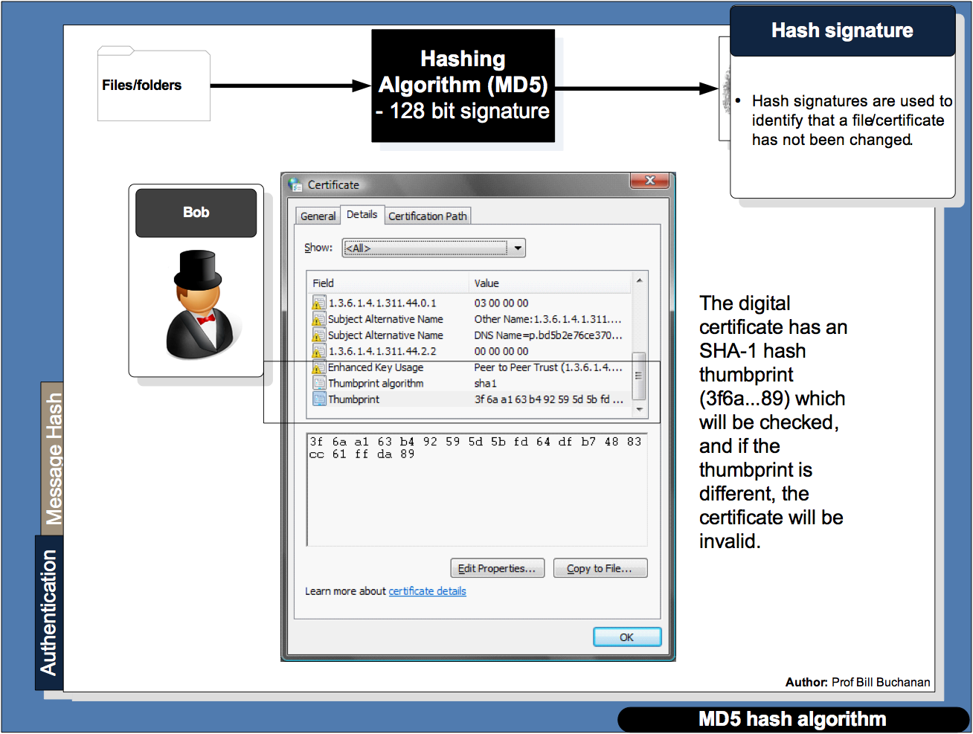

Slide 41
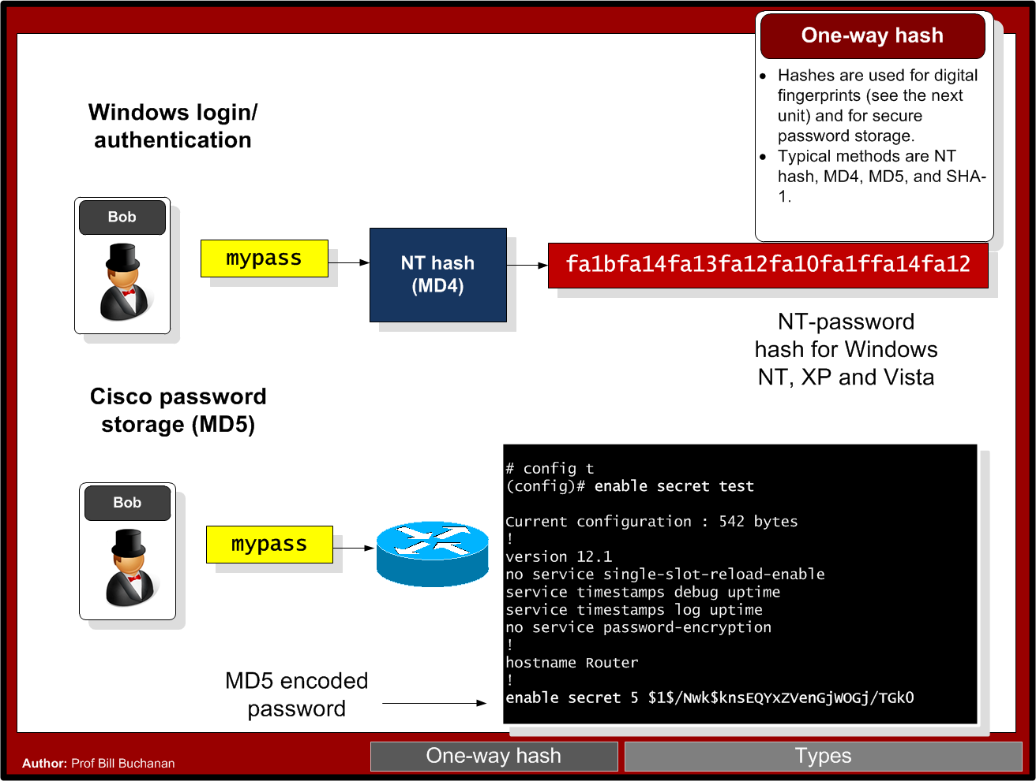

Slide 42
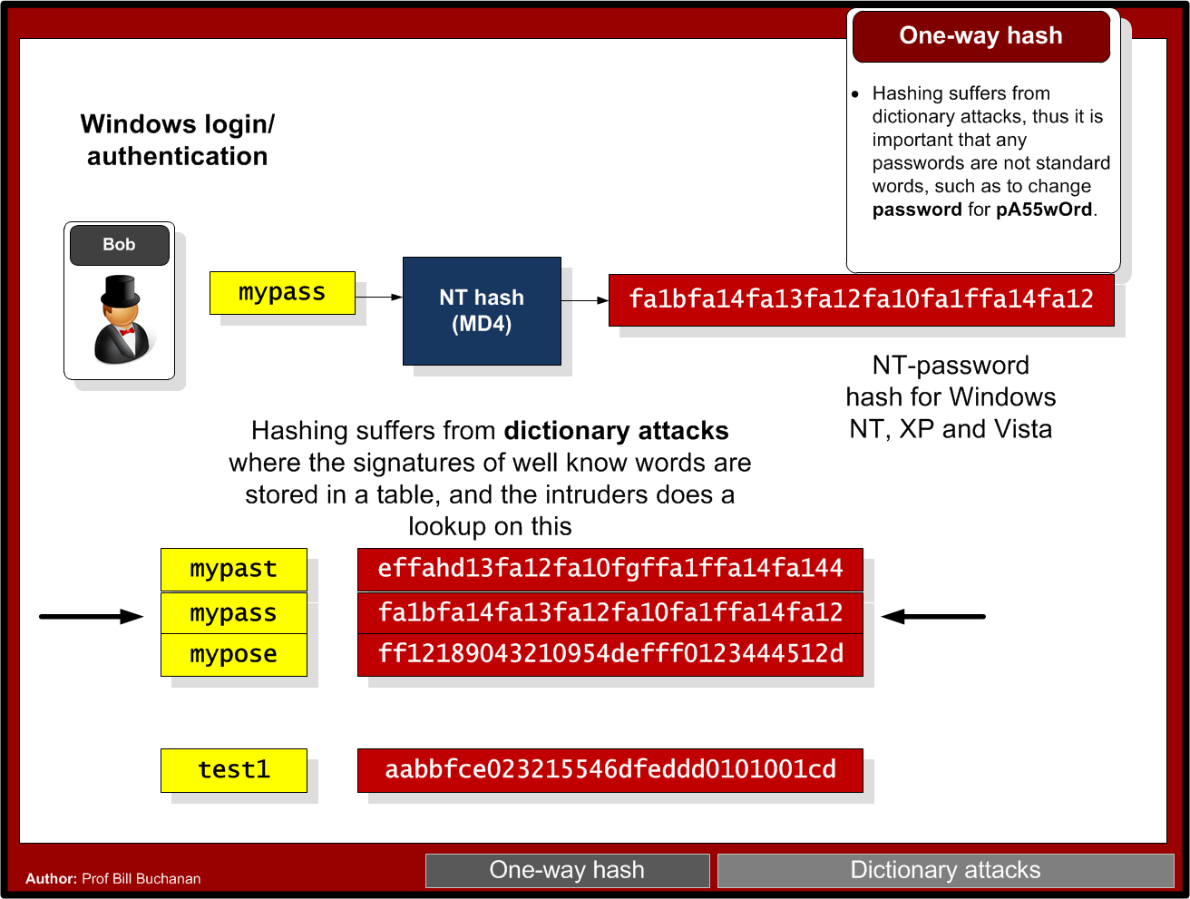

Slide 43
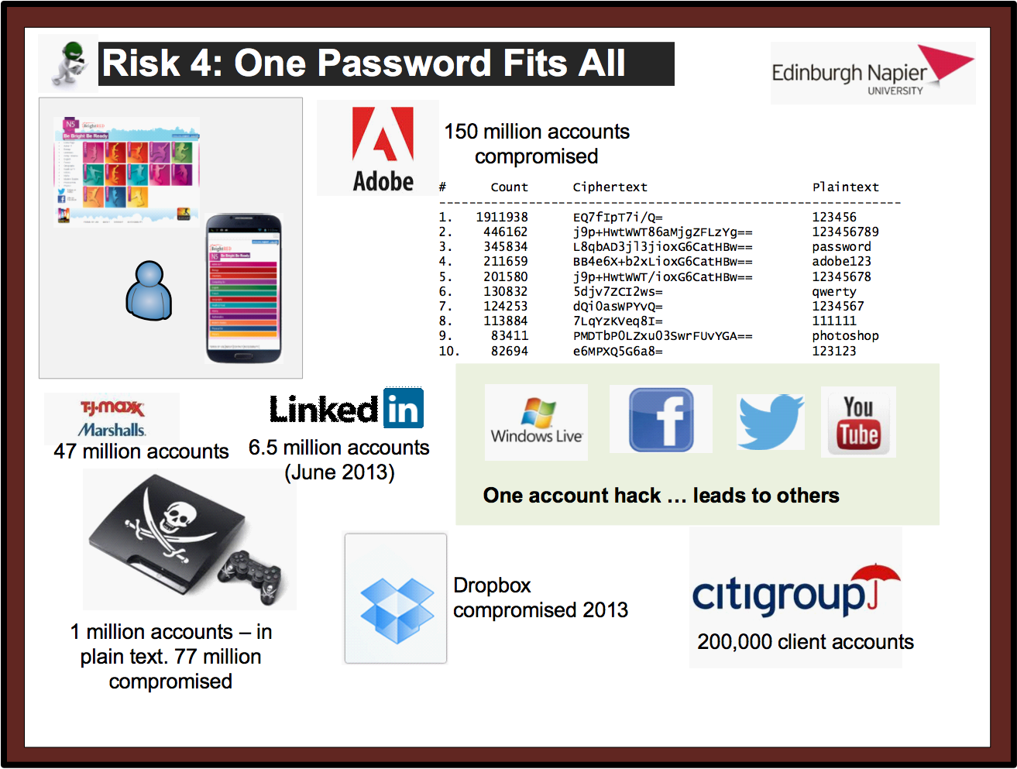

Slide 44
Brute Force - How many hash codes?
7 digit password with [a-z] … how many?
Ans:
Time to crack - 100 billion per second:
7 digit with [a-zA-z] … how many?
Ans:
Time to crack – 100 billion per second:
7 digit with [a-zA-z!@#$%^&*()] … how many?
Ans:
Time to crack – 100 billion per second:

Slide 45
Hashing Hashing Types. Hashing Methods. Salting. Collisions. LM and NTLM Hashes (Windows). Hash Benchmarks. Message Authentication Codes (MACs). OTP/HOTP. Secret Shares. Prof Bill Buchanan OBE http://asecuritysite.com/hash

Slide 46
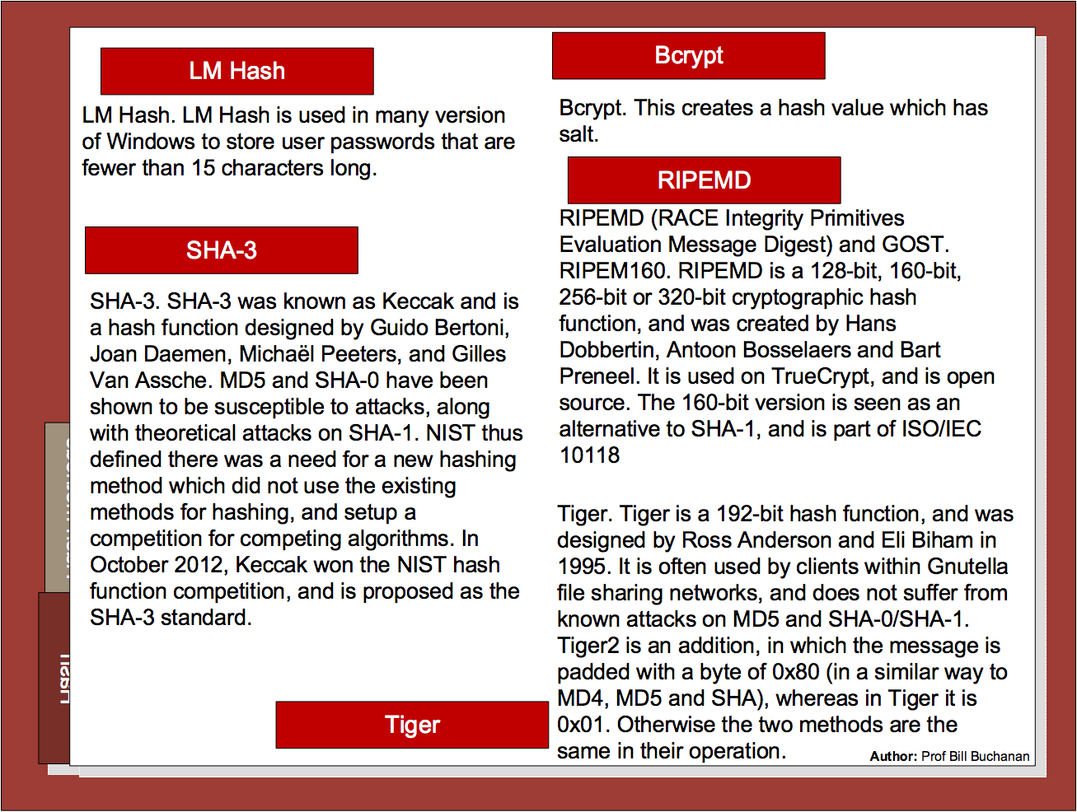

Slide 47
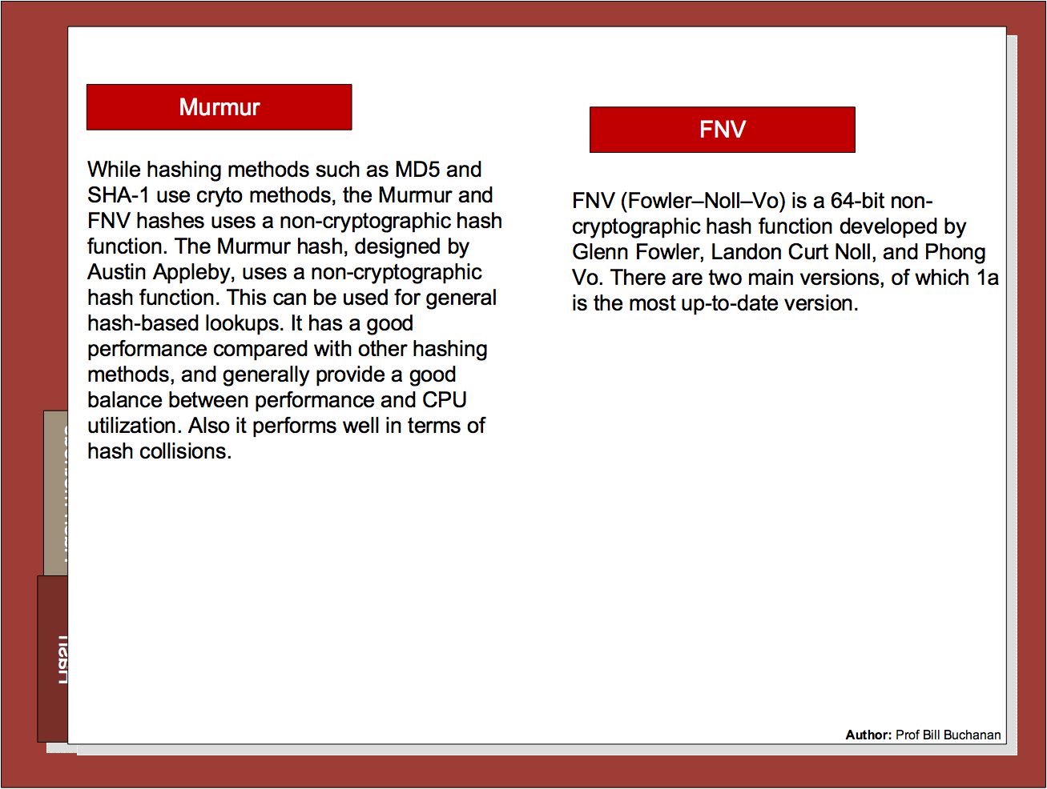

Slide 48
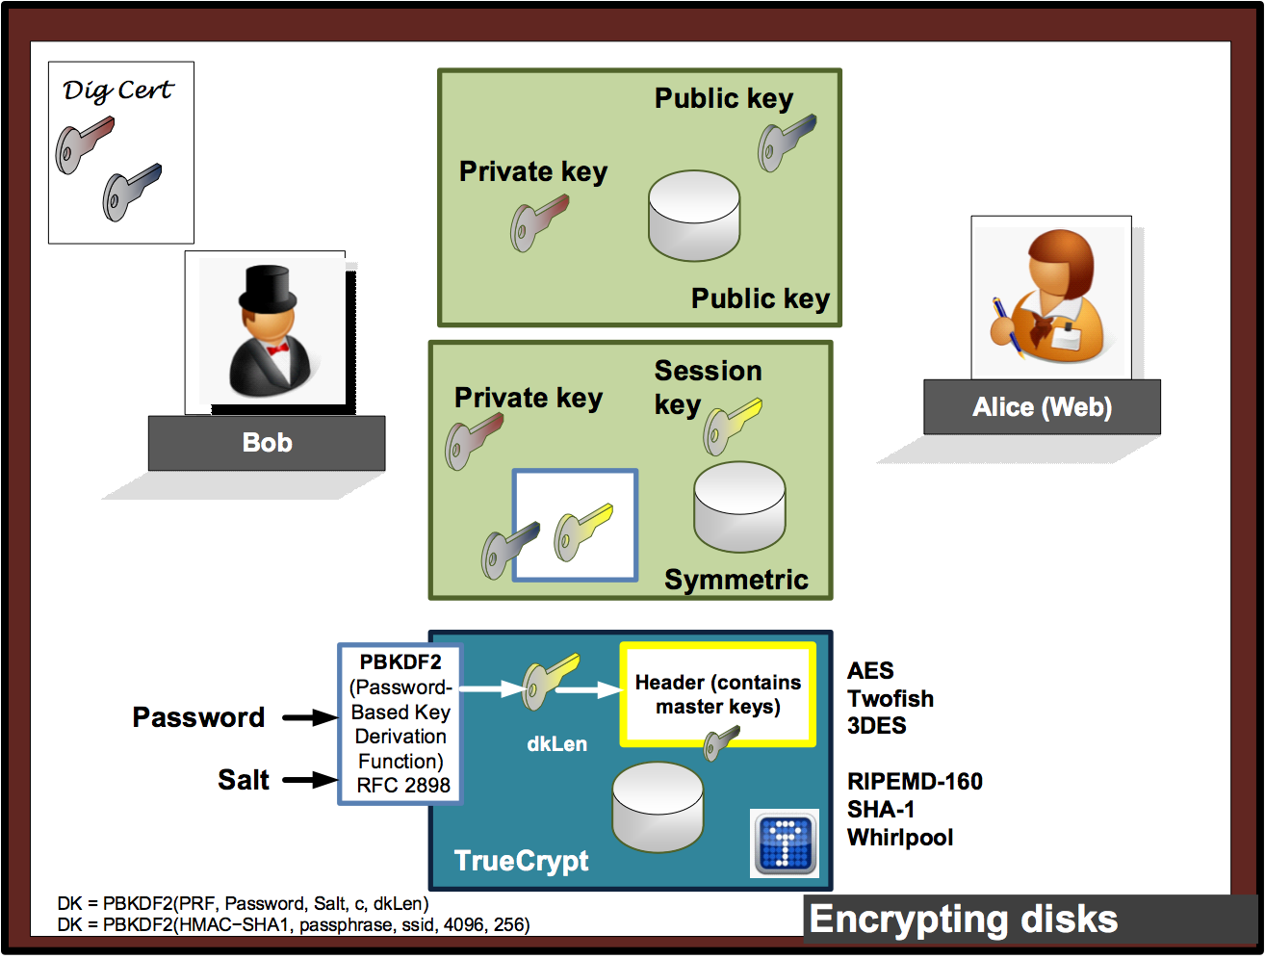

Slide 49
Chapter 3: Hashing Hashing Types. Hashing Methods. Salting. Collisions. LM and NTLM Hashes (Windows). Hash Benchmarks. Message Authentication Codes (MACs). OTP/HOTP. Secret Shares. Prof Bill Buchanan OBE http://asecuritysite.com/hash

Slide 50
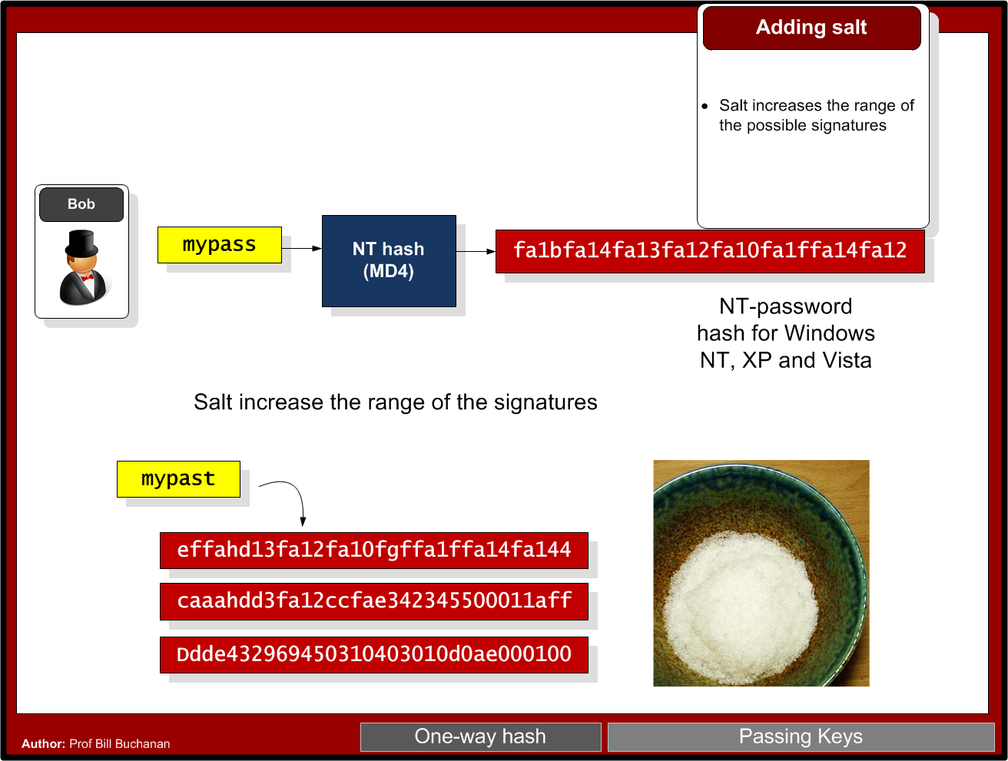

Slide 51
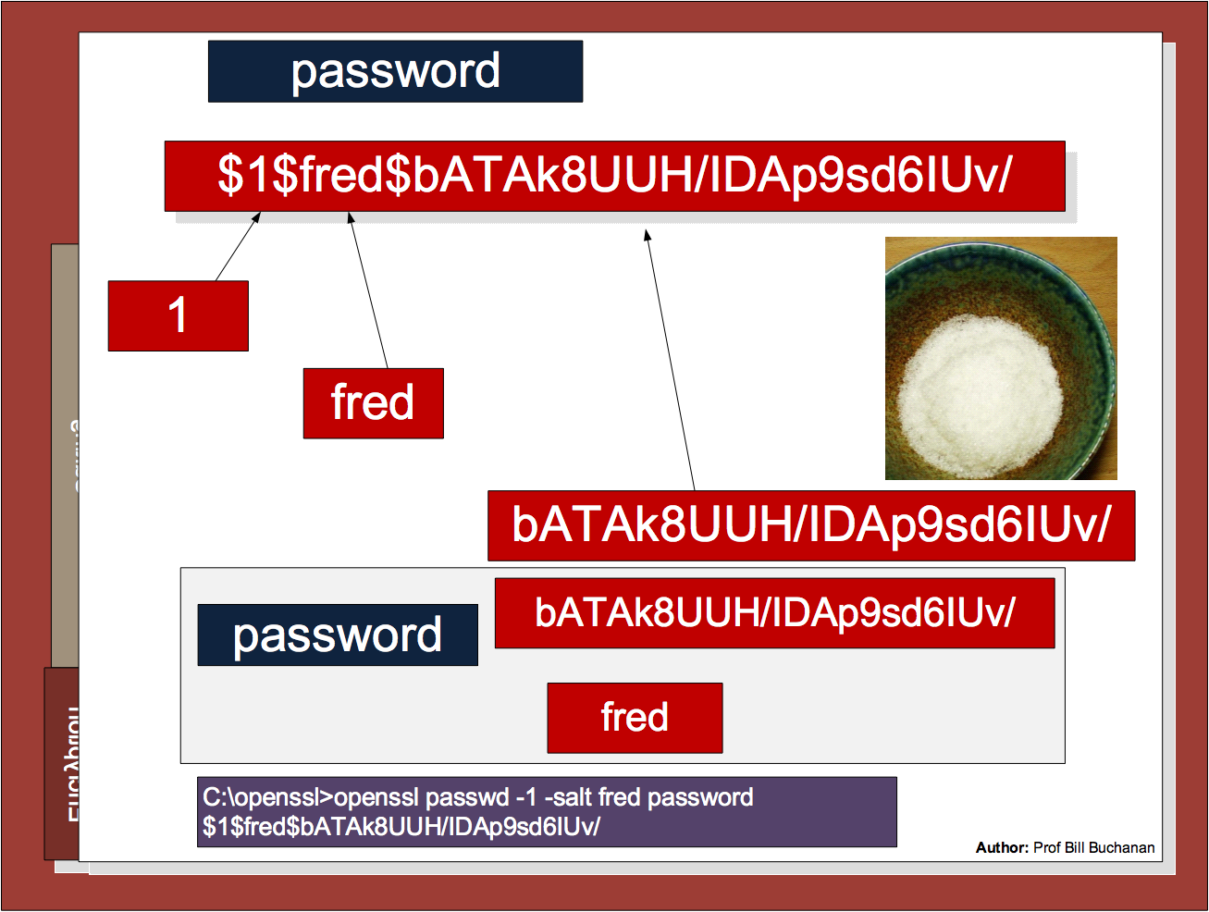

Slide 52
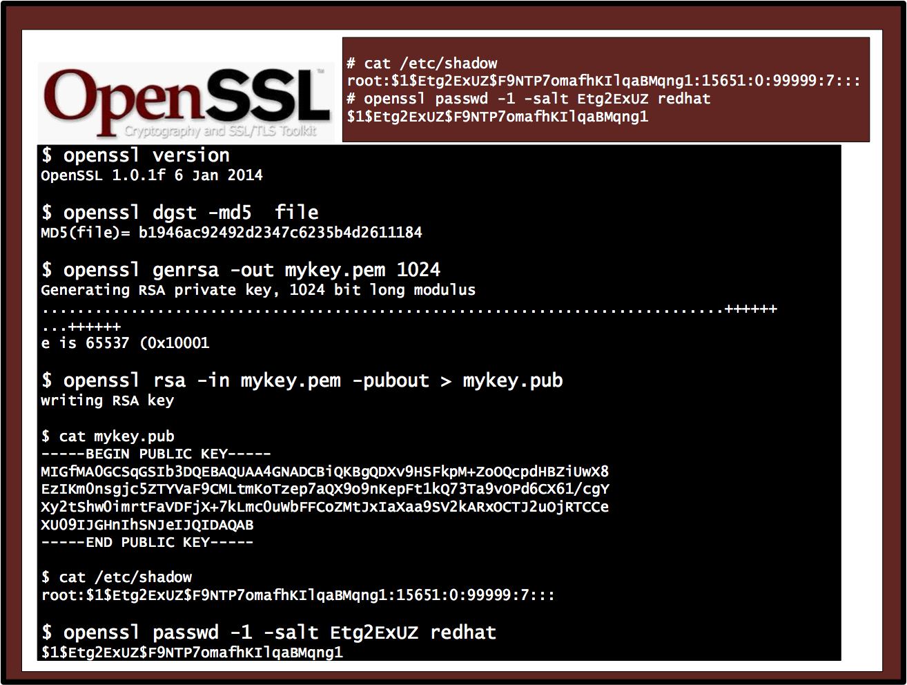

Slide 53
Chapter 3: Hashing Hashing Types. Hashing Methods. Salting. Collisions. LM and NTLM Hashes (Windows). Hash Benchmarks. Message Authentication Codes (MACs). OTP/HOTP. Secret Shares. Prof Bill Buchanan OBE http://asecuritysite.com/hash

Slide 54
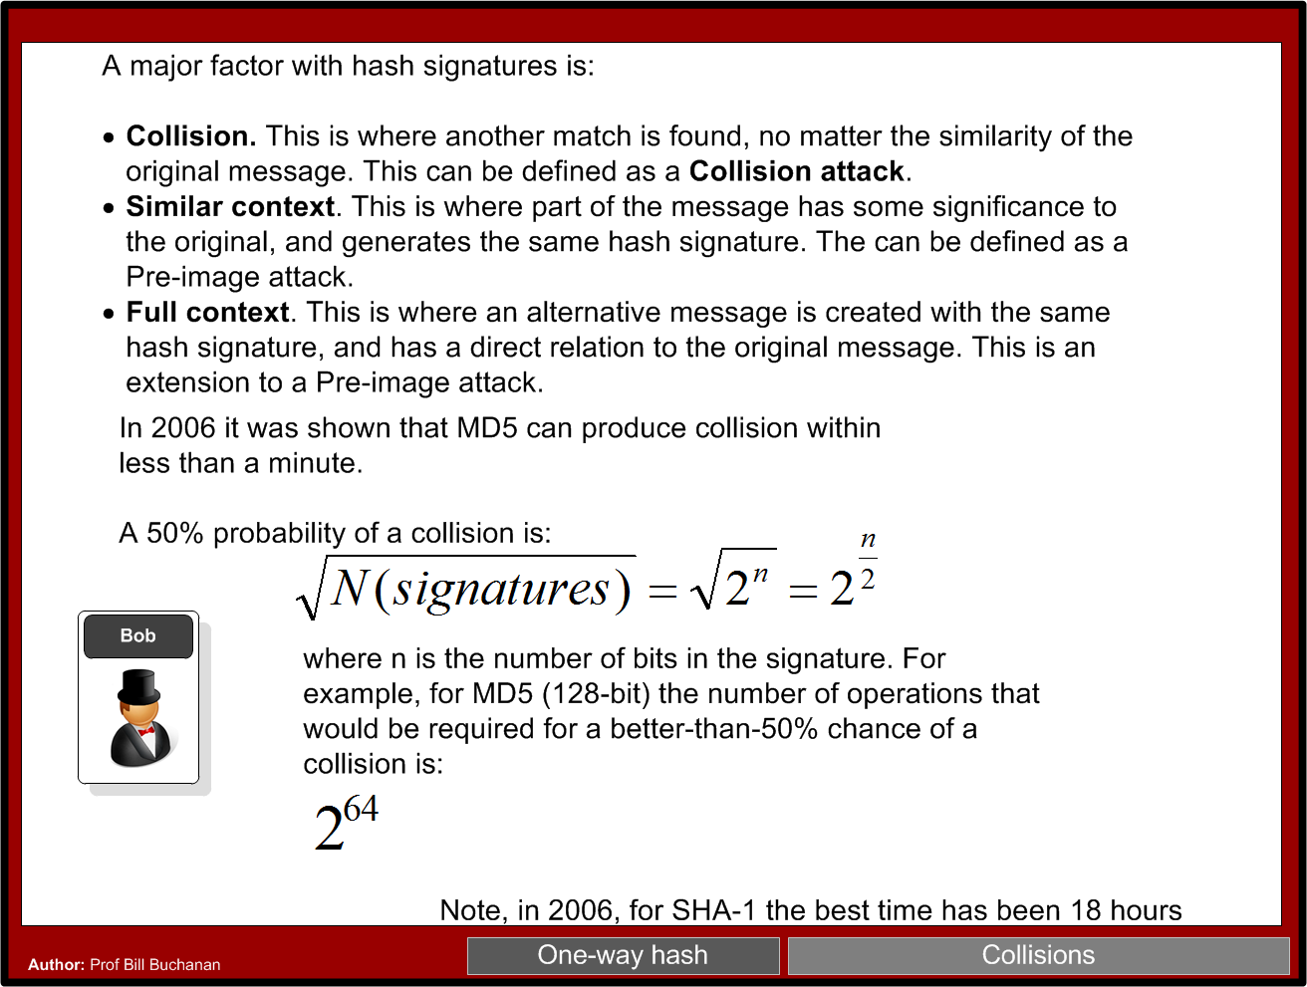

Slide 55
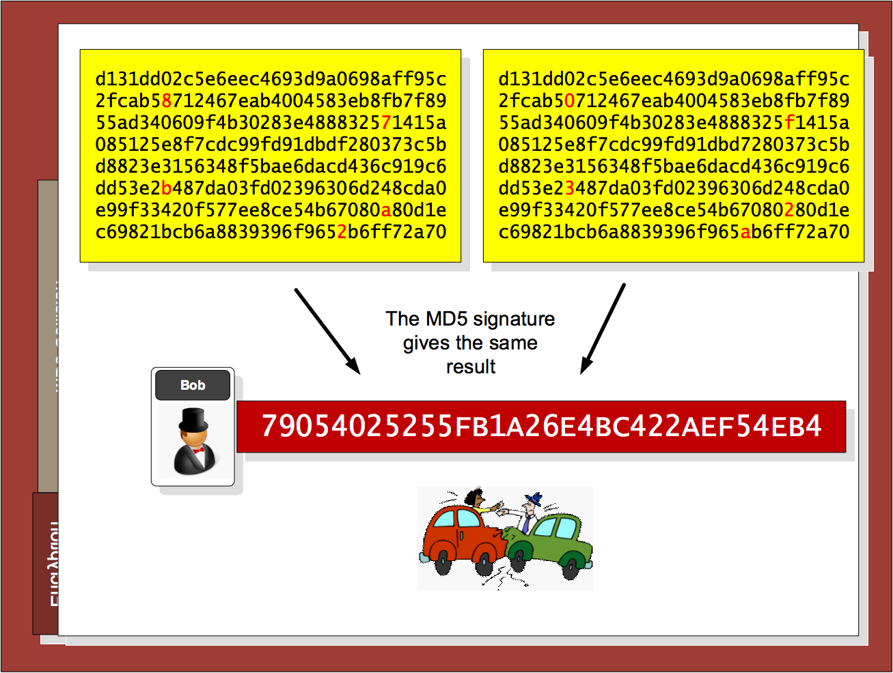

Slide 56
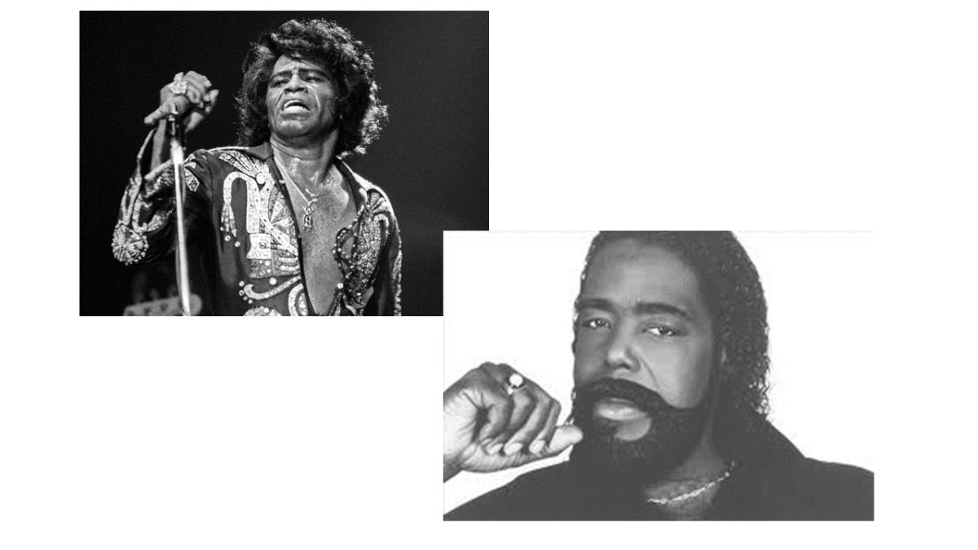
Nat McHugh
10 hours of computing on the Amazon GPU Cloud.
Cost: 60 cents
Used: Hashcat (on CUDA)
Birthday attack: A group size of only 70 people results in a 99.9% chance of two people sharing the same birthday.
M-bit output there are 2^m messages, and the same hash value would only require 2^(m/2) random messages. 18,446,744,073,709,551,616.
C:\openssl>openssl md5 hash01.jpg MD5(hash01.jpg)= e06723d4961a0a3f950e7786f3766338 C:\openssl>openssl md5 hash02.jpg MD5(hash02.jpg)= e06723d4961a0a3f950e7786f3766338

Slide 57
Chapter 3: Hashing Hashing Types. Hashing Methods. Salting. Collisions. LM and NTLM Hashes (Windows). Hash Benchmarks. Message Authentication Codes (MACs). OTP/HOTP. Secret Shares. Prof Bill Buchanan OBE http://asecuritysite.com/hash

Slide 58
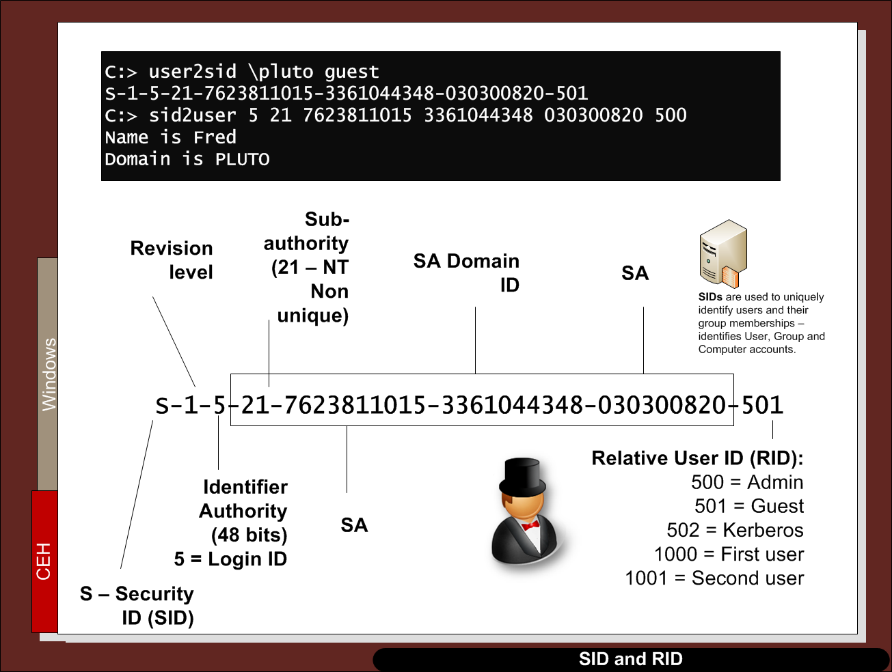

Slide 59
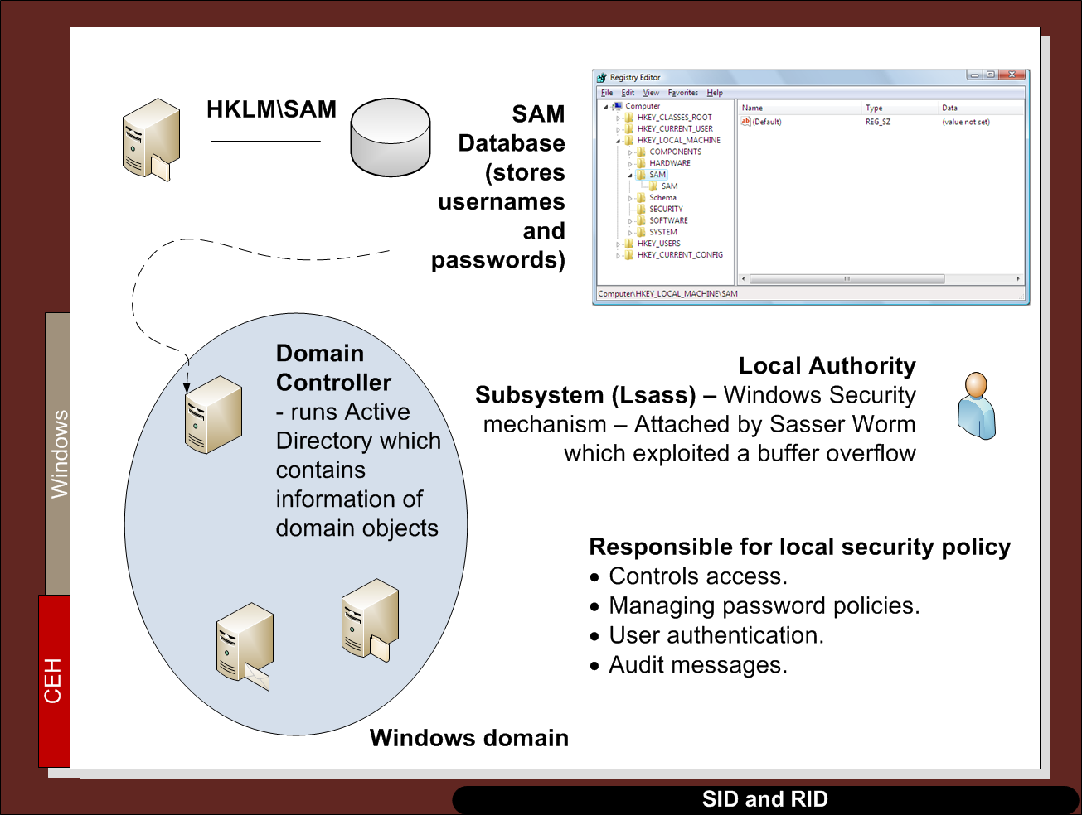

Slide 60
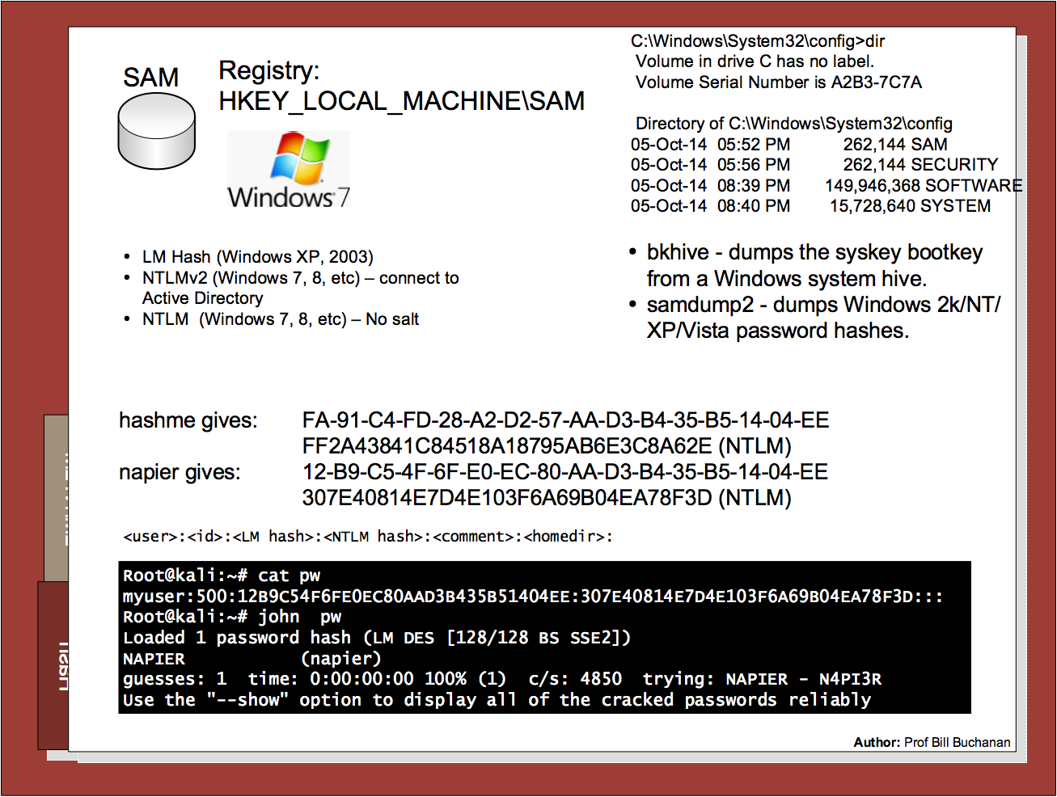

Slide 61
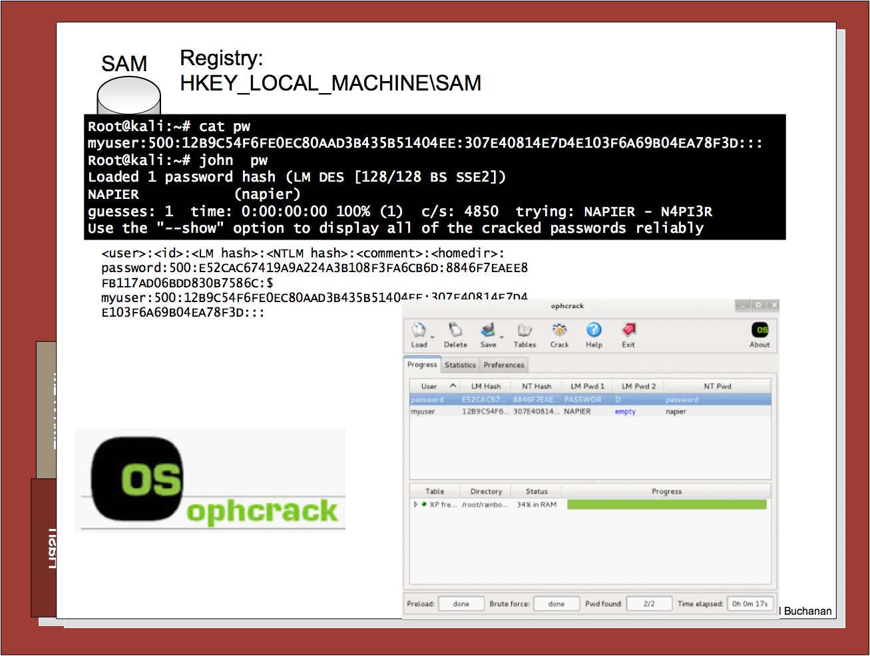

Slide 62
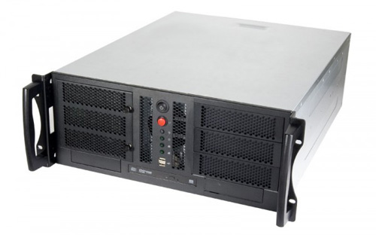
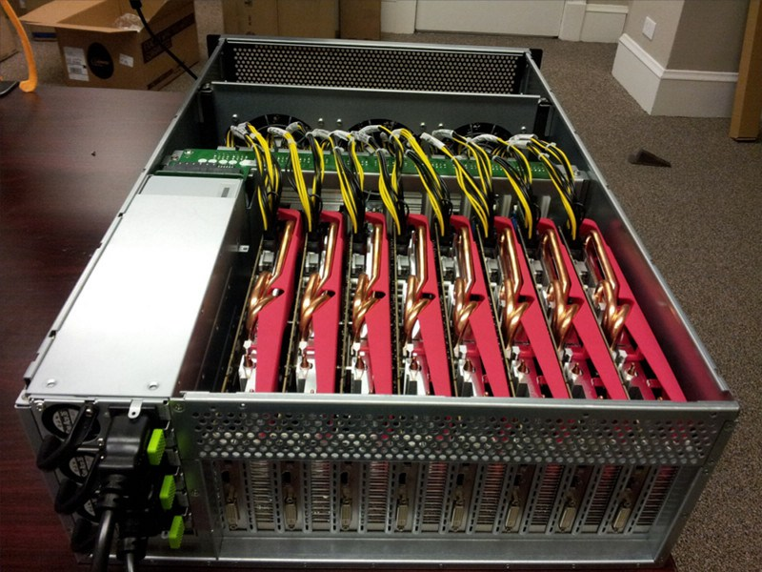
Hash Crackers/Bit Coin Miners
Fast Hash One
1.536TH/s – Cost 3-5,000 dollars.
25 GPU Hash Cracker
An eight character NTLM password cracked in 5.5 hours. 14 character LM hash cracked in six minutes. 350 billion hashes per second.

Slide 63
Chapter 3: Hashing Hashing Types. Hashing Methods. Salting. Collisions. LM and NTLM Hashes (Windows). Hash Benchmarks. Message Authentication Codes (MACs). OTP/HOTP. Prof Bill Buchanan OBE http://asecuritysite.com/hasdh

Slide 64
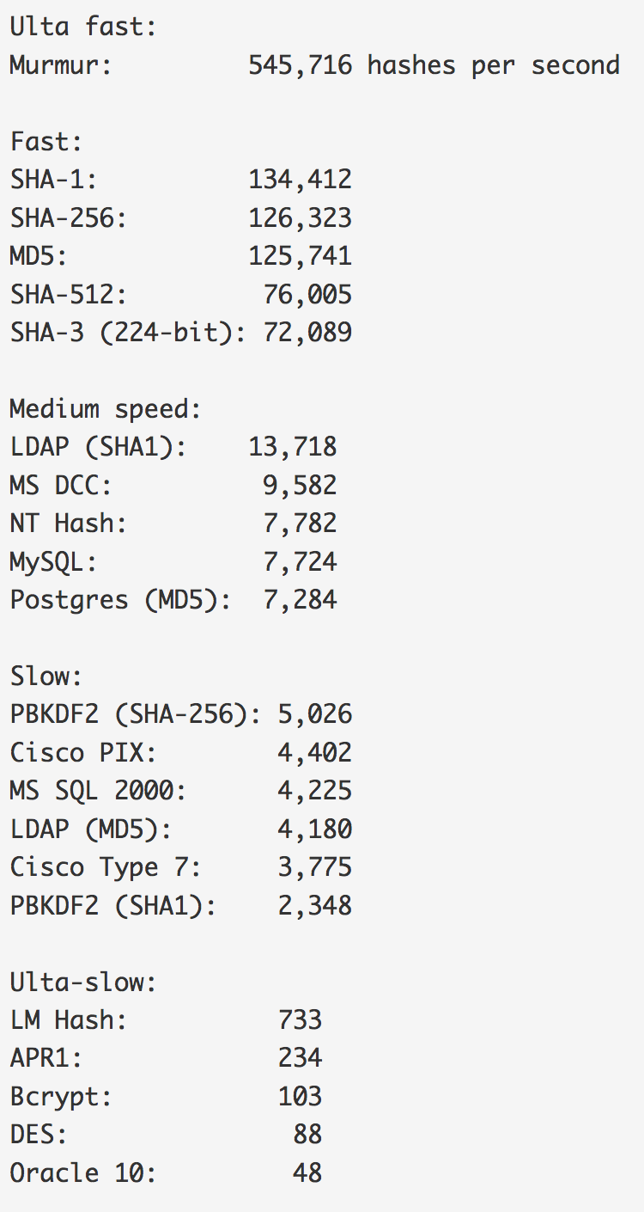
Benchmark
Hashes “The quick brown fox jumps over the lazy dog:
SHA-1: 2fd4e1c67a2d28fced849ee1bb76e7391b93eb12
SHA-256: d7a8fbb307d7809469ca9abcb0082e4f8d5651e46d3cdb762d02d0bf37c9e592
SHA-512: 07e547d9586f6a73f73fbac0435ed76951218fb7d0c8d788a309d7
85436bbb642e93a252a954f23912547d1e8a3b5ed6e1bfd7097821233fa0538f3db854fee6
MD-5: 9e107d9d372bb6826bd81d3542a419d6
DES: ZDeS94Lcq/6zg
Bcrypt: $2a$05$2czCv5GYgkx3aobmEyewB.ejV2hePMdbvTdCyNaSzWtlGPPjB2xx6
APR1: $apr1$ZDzPE45C$3PvRanPycmNc6c2G9wT9b/
PBKDF2 (SHA1): $pbkdf2$5$WkR6UEU0NUM$0RB2bimWrMY.EPYibpaBT2q3HFg
PBKDF2 (SHA-256): $pbkdf2-sha256$5$WkR6UEU0NUM$yrJz2oJix7uBJZwZ/50vWUgdE
I/i0ffqeU4obqC0pk4
LM Hash: a7b07f9948d8cc7f97c4b0b30cae500f
NT Hash: 4e6a076ae1b04a815fa6332f69e2e231
MS DCC: efa9778bbc94a7360f664eb7d7144725
LDAP (MD5): {MD5}9e107d9d372bb6826bd81d3542a419d6
LDAP (SHA1): {SHA}2fd4e1c67a2d28fced849ee1bb76e7391b93eb12
MS SQL 2000: 0x0100BF77CE595DCD1FC87A37B3DEBC27A8C97355CB96B8BAB
63E602662BA5D5D33B913E422499BE72FF3D9BB65DE
MySQL: *A4E4D26FD0C6455E23E2187C3AABE844332AA1B3
Oracle 10: 4CDA2299FCAD0499
Postgres (MD5): md5d44c15daa11770f25c5350f7e5408dd1
Cisco PIX: kGyKN5CqdFQ1qJUs
Cisco Type 7: 15260309443B3E2D2B3875200108010D41505640135E1B0E080
519574156401540035E460B594D1D53020B5C
Benchmark

Slide 65
Hashing Hashing Types. Hashing Methods. Salting. Collisions. LM and NTLM Hashes (Windows). Hash Benchmarks. Message Authentication Codes (MACs). OTP/HOTP. Prof Bill Buchanan OBE http://asecuritysite.com/crypto02 http://asecuritysite.com/encryption

Slide 66
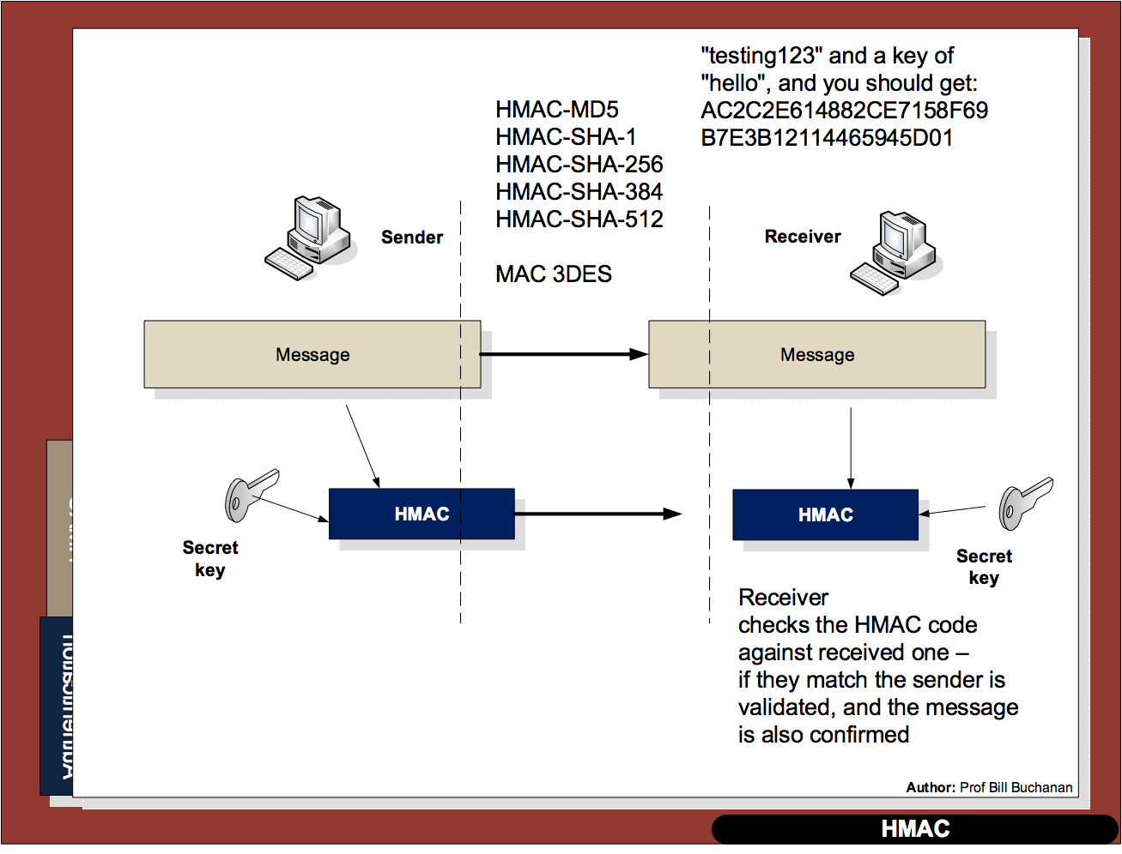

Slide 67
Hashing Hashing Types. Hashing Methods. Salting. Collisions. LM and NTLM Hashes (Windows). Hash Benchmarks. Message Authentication Codes (MACs). OTP/HOTP. Prof Bill Buchanan OBE http://asecuritysite.com/hash

Slide 68
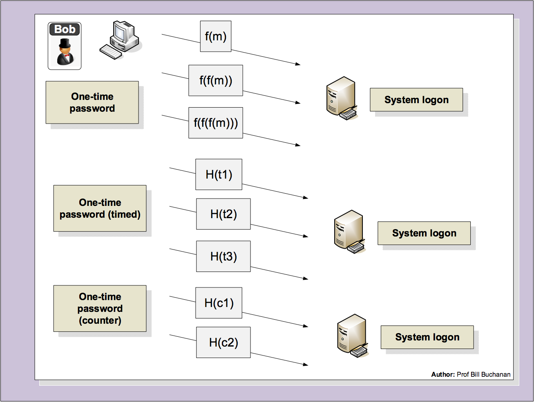

Slide 69
Hashing Hashing Types. Hashing Methods. Salting. Collisions. LM and NTLM Hashes (Windows). Hash Benchmarks. Message Authentication Codes (MACs). OTP/HOTP. Prof Bill Buchanan OBE http://asecuritysite.com/hash

Slide 70
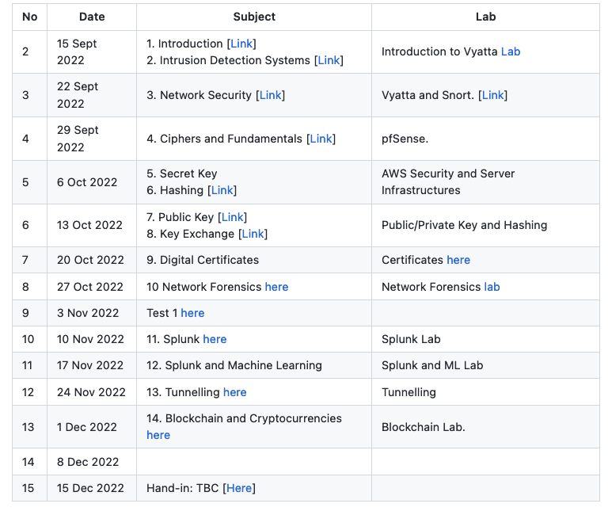

Public Key Basics RSA/ECC Applications (Encryption and Signing) Prof Bill Buchanan OBE https://asecuritysite.com/rsa/

Slide 72

Public Key Methods

Slide 73

Public Key Methods
Integer Factorization. Using prime numbers. Example: RSA. Key size: 2,048 bits (modulus). Signing, Digital Certificates.
Discrete Logarithms. Y = g^{x} mod P. Example: ElGamal. Prime number size: 2,048 bits. Key handshake.
Elliptic Curve Relationships. Example: Elliptic Curve. Private key: 256 bits. Public key: 512 bits. Bitcoin, IoT, Web, etc.

Slide 74
Public Key RSA Prof Bill Buchanan OBE http://asecuritysite.com/crypto04 http://asecuritysite.com/encryption

Slide 75


Slide 76


Slide 77

RSA
Two primes p, q.
Calculate N (modulus) as p x q eg 3 and 11. n=33.
Calculate PHI as (p-1)x(q-1). PHI=20
Select e for no common factor with PHI. e=3.
Encryption key [e,n] or [3,33].
(d x e) mod 20 = 1
(d x 3) mod 20 = 1
d= 7
Decryption key [d,n] or [7,33] (link)

Slide 78
RSA
Calc
Example
Encryption key [e,n] or [3,33].
Decryption key [d,n] or [7,33]
Cipher = Me mod N
eg M=5.
Cipher = 5³ mod 33 = 26
Decipher = C^{d} mod N
Decipher = (26)⁷ mod 33 = 5

Slide 79
Public Key Basics RSA Applications (Encryption and Signing) Prof Bill Buchanan OBE https://asecuritysite.com/rsa/

Slide 80

Public Key Encryption

Slide 81

Public Key Digital Signing

Slide 82
Public Key Basics RSA Applications (Encryption and Signing) Prof Bill Buchanan OBE https://asecuritysite.com/rsa

Slide 83

Key Exchange Diffie-Hellman Diffie-Hellman Weaknesses Passing Key Using Public Key Prof Bill Buchanan OBE http://asecuritysite.com/crypto05 http://asecuritysite.com/encryption

Slide 84


Slide 85


Slide 86
Key Exchange
Forward secrecy (FS), which means that a comprise of the long-term keys will not compromise any previous session keys. A leakage of the public key of the server would cause all the sessions which used this specific public key to be compromised. FS thus aims to overcome this by making sure that all the sessions keys could not be compromised, even though the long-term key was compromised.
Ephemeral. With some key exchange methods, the same key will be generated if the same parameters are used on either side. This can cause problems as an intruder could guess the key, or even where the key was static and never changed. With ephemeral methods, a different key is used for each connection, and, again, the leakage of any long-term would not cause all the associated session keys to be breached.

Slide 90


Slide 91


Slide 92


Slide 93
Diffie-Hellman Generator
Y = g^{x} mod p
Picking G

Slide 94
Diffie-Hellman Generation
C:\> openssl dhparam -out dhparams.pem 768 –text
C:\> type dhparams.pem
Diffie-Hellman-Parameters: (768 bit)
prime:
00:d0:37:c2:95:64:02:ea:12:2b:51:50:a2:84:6c:
71:6a:3e:2c:a9:80:e2:65:b2:a5:ee:77:26:22:31:
66:9e:fc:c8:09:94:e8:9d:f4:cd:bf:d2:37:b2:fb:
b8:38:2c:87:28:38:dc:95:24:73:06:d3:d9:1f:af:
78:01:10:6a:7e:56:4e:7b:ee:b4:8d:6b:4d:b5:9b:
93:c6:f1:74:60:01:0d:96:7e:85:ca:b8:1f:f7:bc:
43:b7:40:4d:4e:87:e3
generator: 2 (0x2)
-----BEGIN DH PARAMETERS-----
MGYCYQDQN8KVZALqEitRUKKEbHFqPiypgOJlsqXudyYiMWae/MgJlOid9M2/0jey
+7g4LIcoONyVJHMG09kfr3gBEGp+Vk577rSNa021m5PG8XRgAQ2WfoXKuB/3vEO3
QE1Oh+MCAQI=
-----END DH PARAMETERS-----
DH Group 5: 1,536 bit prime.
DH Group 2: 1,024 bit prime.
DH Group 1: 768-bit prime.

Slide 95
Key Exchange Diffie-Hellman Diffie-Hellman Weaknesses Passing Key Using Public Key Prof Bill Buchanan OBE http://asecuritysite.com/crypto05 http://asecuritysite.com/encryption

Slide 96
Diffie-Hellman Weaknesses
In 2015, a paper entitled Imperfect Forward Secrecy: How Diffie-Hellman Fails in Practice – showed that it was fairly easy to precompute on values for two popular Diffie-Hellman parameters (and which use the DHE_EXPORT cipher set).
The research team found that one was used as a default in the around 7% of the Top 1 million web sites and was hard coded into the Apache httpd service. Overall, at the time, it was found that over 3% of Web sites were still using the default.
Diffie-Hellman-Parameters: (512 bit)
prime:
00:9f:db:8b:8a:00:45:44:f0:04:5f:17:37:d0:ba:
2e:0b:27:4c:df:1a:9f:58:82:18:fb:43:53:16:a1:
6e:37:41:71:fd:19:d8:d8:f3:7c:39:bf:86:3f:d6:
0e:3e:30:06:80:a3:03:0c:6e:4c:37:57:d0:8f:70:
e6:aa:87:10:33
generator: 2 (0x2)

Slide 97

Eve-in-the-middle

Slide 98
Key Exchange Diffie-Hellman Diffie-Hellman Weaknesses Passing Key Using Public Key Prof Bill Buchanan OBE http://asecuritysite.com/crypto05 http://asecuritysite.com/encryption

Slide 99
Key Exchange with Public Key

Slide 100
Key Exchange Diffie-Hellman Diffie-Hellman Weaknesses Passing Key Using Public Key Prof Bill Buchanan OBE http://asecuritysite.com/crypto05 http://asecuritysite.com/encryption

Slide 101


Digital Certificates Introduction Authentication Methods PKI Digital Certificate Passing Prof Bill Buchanan OBE https://asecuritysite.com/tunnelling

Slide 103


Slide 104


Slide 105


Slide 106


Slide 107


Slide 108


Slide 109
Unit 6: Digital Certificates Introduction Authentication Methods Prof Bill Buchanan OBE https://asecuritysite.com/tunnelling/

Slide 110


Slide 111


Slide 112


Slide 113


Slide 114


Slide 115
Digital Certificates Introduction Authentication Methods PKI Digital Certificate Passing Prof Bill Buchanan OBE https://asecuritysite.com/tunnelling

Slide 116


Slide 117


Slide 118


Slide 119


Slide 120


Slide 121


Slide 122
Digital Certificates Introduction Authentication Methods PKI Certificate Creation Digital Certificate Passing Prof Bill Buchanan OBE https://asecuritysite.com/tunnelling

Slide 123




Slide 124



Slide 125
PEM
PKCS#7
-----BEGIN CERTIFICATE-----
MIIEwTCCA6mgAwIBAgIRAO93GGFLfHwOCAAAAAAucZgwDQYJKoZIhvcNAQELBQAw
QjELMAkGA1UEBhMCVVMxHjAcBgNVBAoTFUdvb2dsZSBUcnVzdCBTZXJ2aWNlczET
MBEGA1UEAxMKR1RTIENBIDFPMTAeFw0yMDAyMTIxMTQ3NDFaFw0yMDA1MDYxMTQ3
NDFaMGgxCzAJBgNVBAYTAlVTMRMwEQYDVQQIEwpDYWxpZm9ybmlhMRYwFAYDVQQH
Ew1Nb3VudGFpbiBWaWV3MRMwEQYDVQQKEwpHb29nbGUgTExDMRcwFQYDVQQDEw53
d3cuZ29vZ2xlLmNvbTBZMBMGByqGSM49AgEGCCqGSM49AwEHA0IABCzzLJYFJb8W
TpQxWL0TySDvfEWCkMe7l81CFspT60knl13YILNdTM22sUwPycyogKjBSaQZ9Axi
hCeGEAiJkbejggJVMIICUTAOBgNVHQ8BAf8EBAMCB4AwEwYDVR0lBAwwCgYIKwYB
BQUHAwEwDAYDVR0TAQH/BAIwADAdBgNVHQ4EFgQU9Ty3t90o7UW9+Hc6kv/j9511
BBwwHwYDVR0jBBgwFoAUmNH4bhDrz5vsYJ8YkBug630J/SswZAYIKwYBBQUHAQEE
WDBWMCcGCCsGAQUFBzABhhtodHRwOi8vb2NzcC5wa2kuZ29vZy9ndHMxbzEwKwYI
KwYBBQUHMAKGH2h0dHA6Ly9wa2kuZ29vZy9nc3IyL0dUUzFPMS5jcnQwGQYDVR0R
BBIwEIIOd3d3Lmdvb2dsZS5jb20wIQYDVR0gBBowGDAIBgZngQwBAgIwDAYKKwYB
BAHWeQIFAzAvBgNVHR8EKDAmMCSgIqAghh5odHRwOi8vY3JsLnBraS5nb29nL0dU
UzFPMS5jcmwwggEFBgorBgEEAdZ5AgQCBIH2BIHzAPEAdgCyHgXMi6LNiiBOh2b5
K7mKJSBna9r6cOeySVMt74uQXgAAAXA5cNqwAAAEAwBHMEUCIQCojKtzOe8l1JYK
HmKnbt1puqT4AE3peMVAVk/WeWGp1QIgBvRMbNkwF6i8+JVv3CfTHKvFd8e00+GY
PbXJZb1drKEAdwBep3P531bA57U2SH3QSeAyepGaDIShEhKEGHWWgXFFWAAAAXA5
cNrLAAAEAwBIMEYCIQCQSONppELPODh65oFT5ZAGsSQz4FsjNNZedgS7WqzLnQIh
AMAru0QUuoE3RWngfhI6W7n1kxkEmd0vSZTe6+Ql+JVuMA0GCSqGSIb3DQEBCwUA
A4IBAQCDU8CVusGstVk1lAmrtg3DyYhNV1UnKyLk3RrHKumwYz5mC25bWGoLVKvv
pwxBN3zA329/9JZq0mnn0vmPMxjTDvh9sVQ7g4znwha/KJfzL8AZKUdldD9O+hDO
tlHtqVqITZPCAI/ANvbHdZiMEePB8eA+oTiw2ucChqLlsop5Mio8ckg7aXG4/QfC
AIDbvkoffK44rs4UEpsaqGe9QqMJjTuO7ZCZrFd1m3geq2ARKPHgPoPM6UbDdqgO
TNQo9C0F5ZlOkOgV/qshvpTO4YzE7TB2U571eYEqNXH48syVx8XSk3P7FjM7FIZ2
IzbJSEipZJm8DsP10fFXpToIn+zK
-----END CERTIFICATE-----
-----BEGIN PKCS7-----
MIIE8gYJKoZIhvcNAQcCoIIE4zCCBN8CAQExADALBgkqhkiG9w0BBwGgggTFMIIE
wTCCA6mgAwIBAgIRAO93GGFLfHwOCAAAAAAucZgwDQYJKoZIhvcNAQELBQAwQjEL
MAkGA1UEBhMCVVMxHjAcBgNVBAoTFUdvb2dsZSBUcnVzdCBTZXJ2aWNlczETMBEG
A1UEAxMKR1RTIENBIDFPMTAeFw0yMDAyMTIxMTQ3NDFaFw0yMDA1MDYxMTQ3NDFa
MGgxCzAJBgNVBAYTAlVTMRMwEQYDVQQIEwpDYWxpZm9ybmlhMRYwFAYDVQQHEw1N
b3VudGFpbiBWaWV3MRMwEQYDVQQKEwpHb29nbGUgTExDMRcwFQYDVQQDEw53d3cu
Z29vZ2xlLmNvbTBZMBMGByqGSM49AgEGCCqGSM49AwEHA0IABCzzLJYFJb8WTpQx
WL0TySDvfEWCkMe7l81CFspT60knl13YILNdTM22sUwPycyogKjBSaQZ9AxihCeG
EAiJkbejggJVMIICUTAOBgNVHQ8BAf8EBAMCB4AwEwYDVR0lBAwwCgYIKwYBBQUH
AwEwDAYDVR0TAQH/BAIwADAdBgNVHQ4EFgQU9Ty3t90o7UW9+Hc6kv/j9511BBww
HwYDVR0jBBgwFoAUmNH4bhDrz5vsYJ8YkBug630J/SswZAYIKwYBBQUHAQEEWDBW
MCcGCCsGAQUFBzABhhtodHRwOi8vb2NzcC5wa2kuZ29vZy9ndHMxbzEwKwYIKwYB
BQUHMAKGH2h0dHA6Ly9wa2kuZ29vZy9nc3IyL0dUUzFPMS5jcnQwGQYDVR0RBBIw
EIIOd3d3Lmdvb2dsZS5jb20wIQYDVR0gBBowGDAIBgZngQwBAgIwDAYKKwYBBAHW
eQIFAzAvBgNVHR8EKDAmMCSgIqAghh5odHRwOi8vY3JsLnBraS5nb29nL0dUUzFP
MS5jcmwwggEFBgorBgEEAdZ5AgQCBIH2BIHzAPEAdgCyHgXMi6LNiiBOh2b5K7mK
JSBna9r6cOeySVMt74uQXgAAAXA5cNqwAAAEAwBHMEUCIQCojKtzOe8l1JYKHmKn
bt1puqT4AE3peMVAVk/WeWGp1QIgBvRMbNkwF6i8+JVv3CfTHKvFd8e00+GYPbXJ
Zb1drKEAdwBep3P531bA57U2SH3QSeAyepGaDIShEhKEGHWWgXFFWAAAAXA5cNrL
AAAEAwBIMEYCIQCQSONppELPODh65oFT5ZAGsSQz4FsjNNZedgS7WqzLnQIhAMAr
u0QUuoE3RWngfhI6W7n1kxkEmd0vSZTe6+Ql+JVuMA0GCSqGSIb3DQEBCwUAA4IB
AQCDU8CVusGstVk1lAmrtg3DyYhNV1UnKyLk3RrHKumwYz5mC25bWGoLVKvvpwxB
N3zA329/9JZq0mnn0vmPMxjTDvh9sVQ7g4znwha/KJfzL8AZKUdldD9O+hDOtlHt
qVqITZPCAI/ANvbHdZiMEePB8eA+oTiw2ucChqLlsop5Mio8ckg7aXG4/QfCAIDb
vkoffK44rs4UEpsaqGe9QqMJjTuO7ZCZrFd1m3geq2ARKPHgPoPM6UbDdqgOTNQo
9C0F5ZlOkOgV/qshvpTO4YzE7TB2U571eYEqNXH48syVx8XSk3P7FjM7FIZ2IzbJ
SEipZJm8DsP10fFXpToIn+zKoQAxAA==
-----END PKCS7-----
X.509 Certificate (PEM)
X.509 Certificate (DER)
X.509 Certificate (PKCS#7)
PKCS#1 v2 - Padding for Public Key
PKCS #7 v1.5 - Cryptography Message Syntax
PKCS 10 v1.7 - Certificate Request Standard.
Base64
Base64
openssl x509 -outform der -in www-google-com.pem -out google.crt
openssl pkcs12 -export -in server.pem -out keystore.pkcs12
Binary
DER
CER

Slide 126
Digital Certificates Introduction Authentication Methods PKI Digital Certificate Passing Prof Bill Buchanan OBE http://asecuritysite.com/crypto06 http://asecuritysite.com/encryption

Slide 127


Slide 128


Slide 129


Slide 130


Slide 131


Slide 132


Slide 133


Slide 134


Slide 135


Slide 136


Slide 137


Slide 138
Chapter 6: Digital Certificates Introduction Authentication Methods PKI Digital Certificate Passing Prof Bill Buchanan OBE https://asecuritysite.com/tunnelling

Slide 139


Slide 140


Slide 141


Slide 142


Slide 143


Slide 144


Slide 145


Slide 146


Slide 147


Slide 148


Slide 149


Slide 150


Slide 151


Slide 152


Slide 153


Slide 154


Slide 155
Digital Certificates Introduction Authentication Methods PKI Digital Certificate Passing Prof Bill Buchanan OBE https://asecuritysite.com/tunnelling

